Slide 1
&
Composition
Identity
While studying the concept of composition, the arrangement of elements within a work of art, student-artists created designs using letters, numbers, logos, and symbols. Students looked at the concepts of communication, presentation, and that of a narrative, “telling viewers a story” about themselves with these colorful pieces!
-Mr. Smith & Ms. Salatino

Slide 2
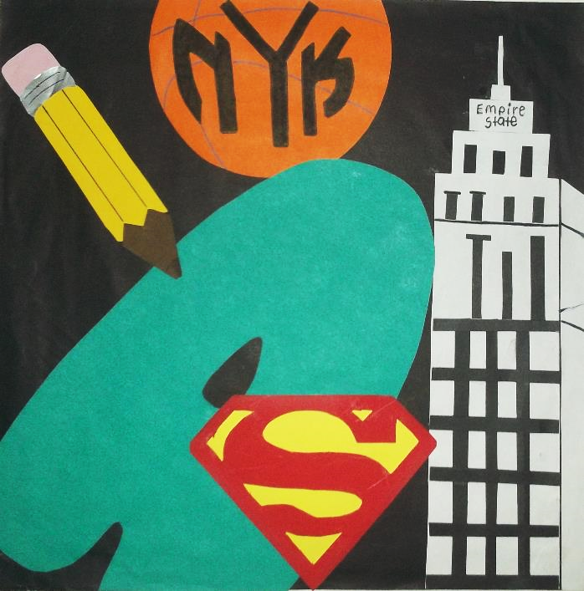
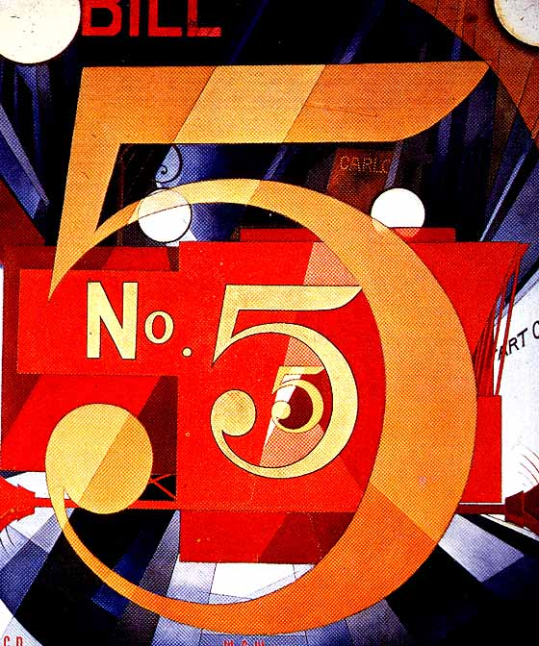
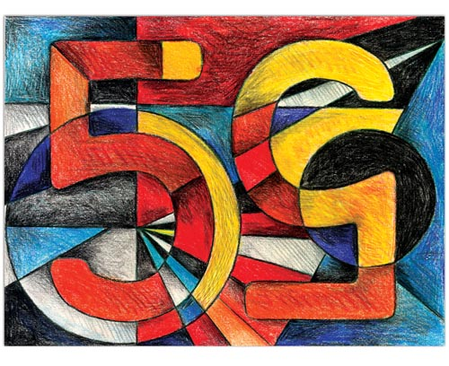

Slide 3
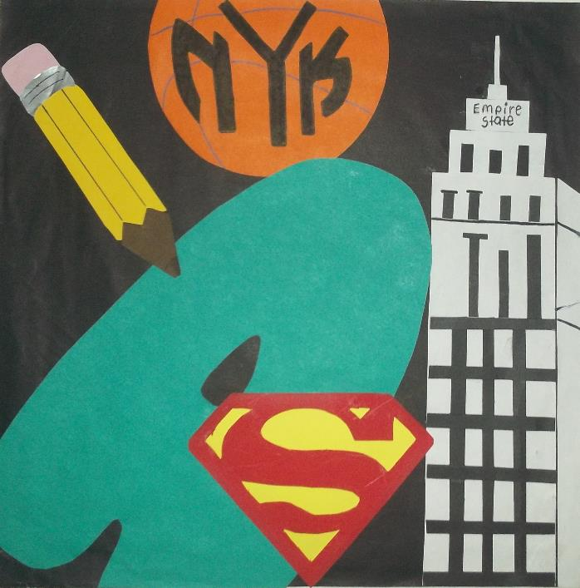
A good composition has:
BALANCE: Is the “weight” of the colors or light/dark spread out well?
UNITY: Does everything look like it goes together?
MOVEMENT: Does the piece make you move your eyes around? IS IT INTERESTING??

Slide 4
&
Composition
Identity
Charles Demuth, I Saw the Figure 5 in Gold, 1928, Oil on Panel

Slide 5
(Charles) Demuth completed eight abstract portraits between 1924 and 1929 as tributes to modern American artists, writers, and performers. Though not a physical likeness, Demuth created this portrait of his friend, the poet and physician William Carlos Williams, using imagery from Williams’s poem “The Great Figure,” which evokes the sights and sounds of a fire engine speeding down the street. The intersecting lines, repeated “5,” round forms of the numbers, lights, street lamp, and blaring sirens of the red fire engine together infuse the painting with a vibrant, urban energy. Demuth derived the title from the poem, which reads:
Among the rain and lights I saw the figure 5 in gold on a red firetruck moving tense unheeded to gong clangs siren howls and wheels rumbling through the dark city

Slide 6
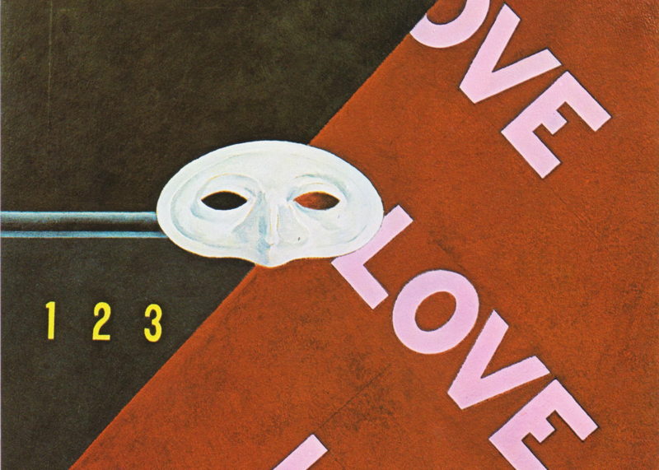
Charles Demuth, Love, Love, Love. Homage to Gertrude Stein, 1928, Oil on Panel

Slide 7
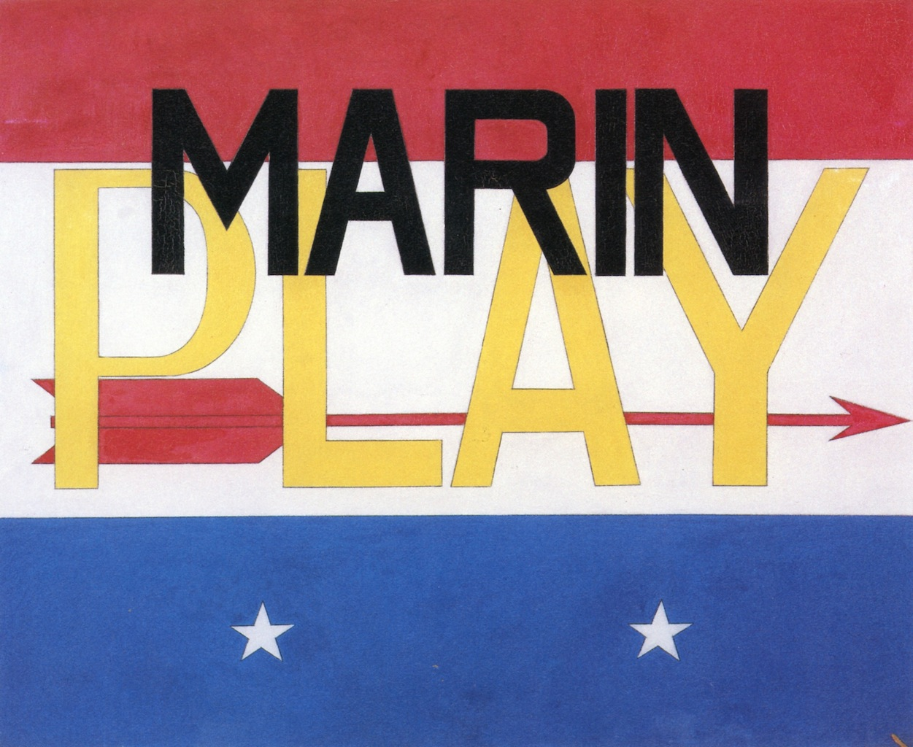
Charles Demuth, Poster Portrait of John Marin, 1926, Poster Paint on Panel

Slide 8
GLOBAL CONTEXT
Identities and relationships
Students explore identity and communicate their ideas and beliefs about their own background.
Statement of Inquiry: Composition communicates a narrative.

Slide 9
KEY CONCEPT
COMMUNICATION
Related Concepts
IDENTITY
COMPOSITION
PRESENTATION
NARRATIVE

Slide 10
SYMBOLS

Slide 11
ATL 1 SELF MANAGEMENT
Organization Skills
Reflection Skills
Process Journal Work
ATL 2 THINKING
Creative Thinking Skills
Transfer Skills
Ideas to final product

Slide 12
Composition: Arrangement of elements in art.
C
C

Slide 13
A good composition has:
BALANCE: Is the “weight” of the colors or light/dark spread out well?
UNITY: Does everything look like it goes together?
MOVEMENT: Does the piece make you move your eyes around? IS IT
INTERESTING??
KEY CONCEPT
COMMUNICATION
GLOBAL CONTEXT :
Identities and Relationships
Related Concepts
IDENTITY
COMPOSITION
PRESENTATION
NARRATIVE
Statement of Inquiry: Composition communicates a narrative.
STEPS FOR YOUR Poster Portrait Project:
Come up with Symbols/icons/elements for your “Self Portrait”
– Things about you, games you like, school, sports, food, clothes, places you’ve been, family, pets, favorite: color, TV show, movie, band/singer/song, etc.
- List 4-5 of them on your thumbnail page and draw each once on a blank sheet of your sketchbook, for practice. Think BASIC, simple symbols.
“Though not a physical likeness, Demuth created this portrait of his friend, the poet and physician William Carlos Williams, using imagery from Williams’s poem ‘The Great Figure’,”
-Metropolitan Museum of Art
2) 4 Thumbnails on the “Thumbnail Page”
– 4 different ideas using your symbols – MUST HAVE 4 DIFFERENT
EACH MUST HAVE: at least one symbol, at least one letter from your initials (BUT you can use your first/last/full name if you like!), at least 1-2 more shapes/elements, text
- Elements/shapes/lines/patterns can repeat!! You can have 1 bird, or 7 birds, or 17!
Charles Demuth, I Saw the Figure 5 in Gold, 1928, Oil on Panel
Composition: Arrangement of elements in art.
3) Get a white sheet of final paper (cut to squares)
4) Draw lightly: Put your chosen composition on the white paper
5) COLOR! Using colored pencils we will make these BOLD!
REMEMBER: Your composition MUST have at least one letter/initial or your name, at least 1-2 symbols, and at least 1-2 added symbols or shapes or other design element

Slide 16
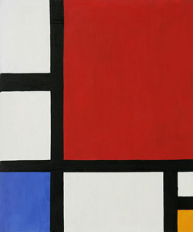
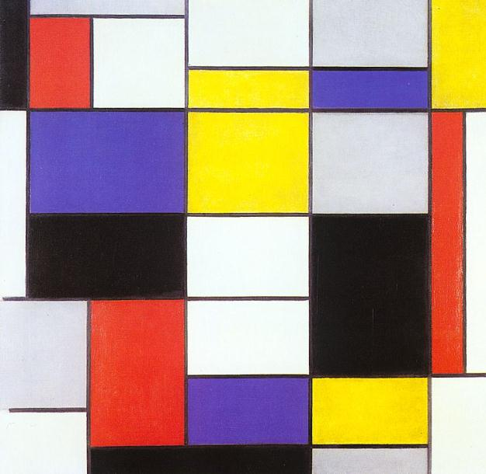
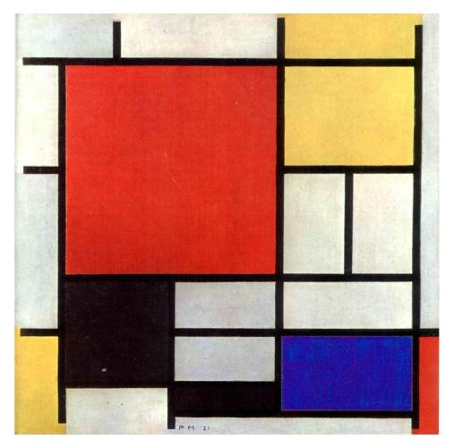

Slide 17
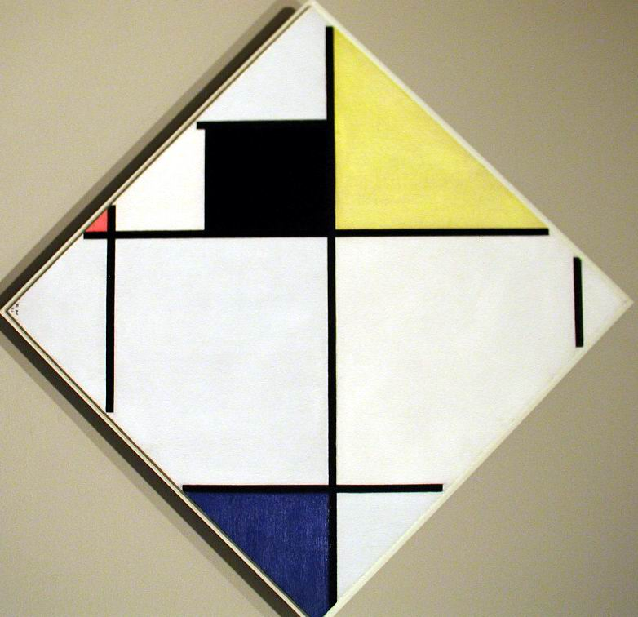

Slide 18
A good composition has:
BALANCE: Is the “weight” of the colors or light/dark spread out well?
UNITY: Does everything look like it goes together?
MOVEMENT: Does the piece make you move your eyes around? IS IT INTERESTING??

Slide 19
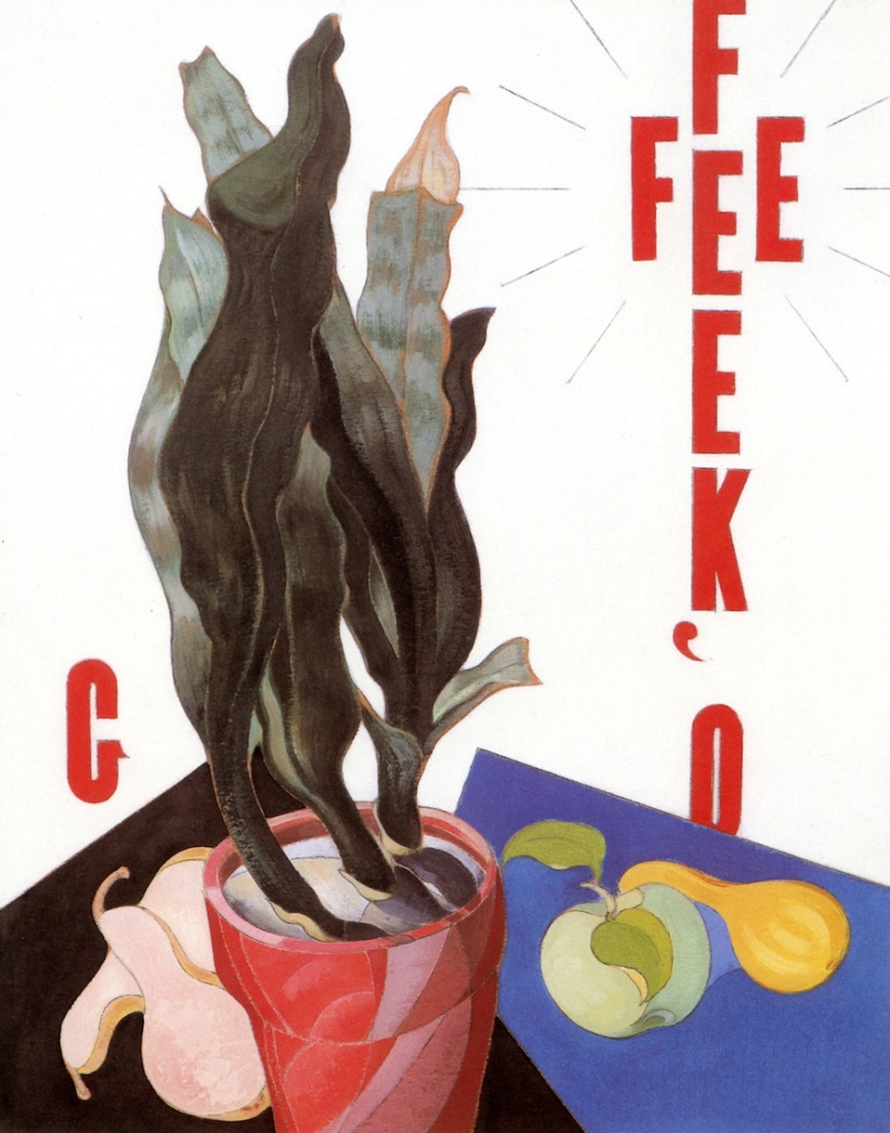
YOUR PROJECT IS LIKE Demuth’s:
Use a few symbols, colors, shapes, and letters/numbers to create a “portrait” of yourself!
You will need:
LETTERS: Your name, or initials, or 1 initial
SYMBOLS: 1-3 symbols about yourself, interests or other things about you!
Text: Some text that relates to you personally (favorite book, song lyrics, quote)
ELEMENTS: Shapes, lines, numbers, or other symbols to add to the poster.
A GOOD COMPOSITION: Put it together in a way that creates an interesting, vibrant poster!
Charles Demuth, Poster Portrait of Georgia OKeefe,
1924, Oil on Panel

Slide 20
A good composition has:
BALANCE: Is the “weight” of the colors or light/dark spread out well?
UNITY: Does everything look like it goes together?
MOVEMENT: Does the piece make you move your eyes around? IS IT
INTERESTING??
KEY CONCEPT
COMMUNICATION
GLOBAL CONTEXT :
Identities and Relationships
Related Concepts
IDENTITY
COMPOSITION
PRESENTATION
NARRATIVE
Statement of Inquiry: Composition communicates a narrative.
STEPS FOR YOUR Poster Portrait Project:
Come up with Symbols/icons/elements for your “Self Portrait”
– Things about you, games you like, school, sports, food, clothes, places you’ve been, family, pets, favorite: color, TV show, movie, band/singer/song, etc.
- List 4-5 of them on your thumbnail page and draw each once on a blank sheet of your sketchbook, for practice. Think BASIC, simple symbols.
“Though not a physical likeness, Demuth created this portrait of his friend, the poet and physician William Carlos Williams, using imagery from Williams’s poem ‘The Great Figure’,”
-Metropolitan Museum of Art
2) 4 Thumbnails on the “Thumbnail Page”
– 4 different ideas using your symbols – MUST HAVE 4 DIFFERENT
EACH MUST HAVE: at least one symbol, at least one letter from your initials (BUT you can use your first/last/full name if you like!), at least 1-2 more shapes/elements
- Elements/shapes/lines/patterns can repeat!! You can have 1 bird, or 7 birds, or 17!
Charles Demuth, I Saw the Figure 5 in Gold, 1928, Oil on Panel
Composition: Arrangement of elements in art.
3) Get a white sheet of final paper (cut to squares)
4) Draw lightly: Put your chosen composition on the white paper
5) COLOR! Using colored pencils we will make these BOLD!
REMEMBER: Your composition MUST have at least one letter/initial or your name, at least 1-2 symbols, and at least 1-2 added symbols or shapes or other design element

Slide 21
CREATE THIS!!!!
POSTER PORTRAIT PROJECT
THUMBNAIL PAGE
Draw 4 small rough ideas for your
Composition. Use the elements/
Symbols listed to the right with a
Letter or letters, numbers, to create
Your 4 different ideas. Your “Notes &
Project Page” has the details.
Symbol Ideas (write them here, likes,
hobbies, things about you!):
_____________________________
_____________________________
_____________________________
_____________________________

Slide 22
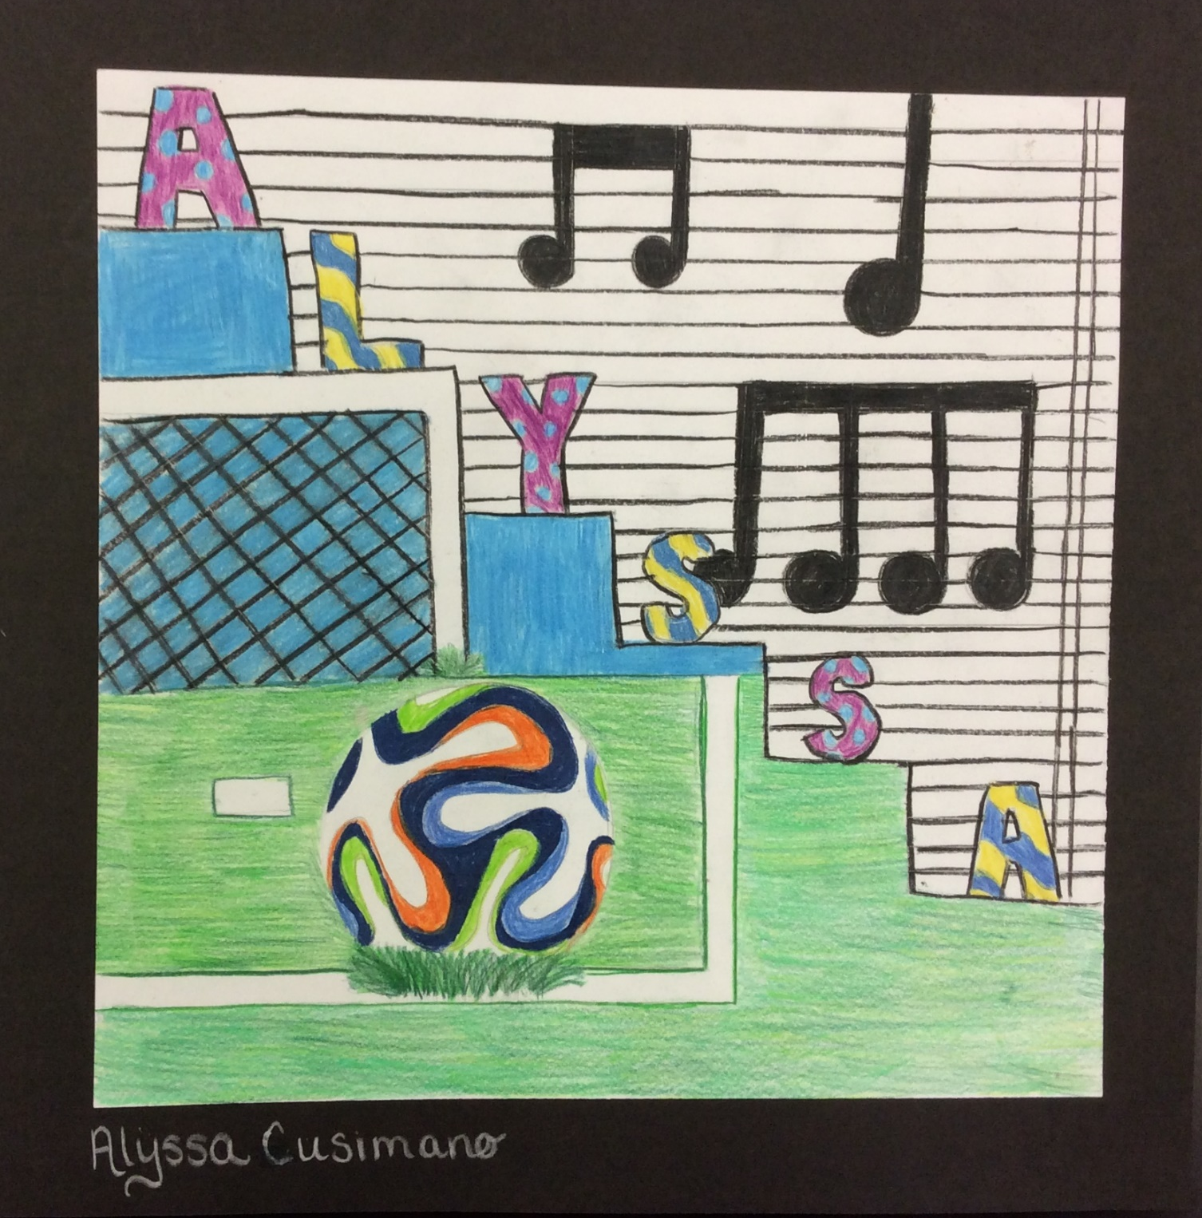

Slide 24
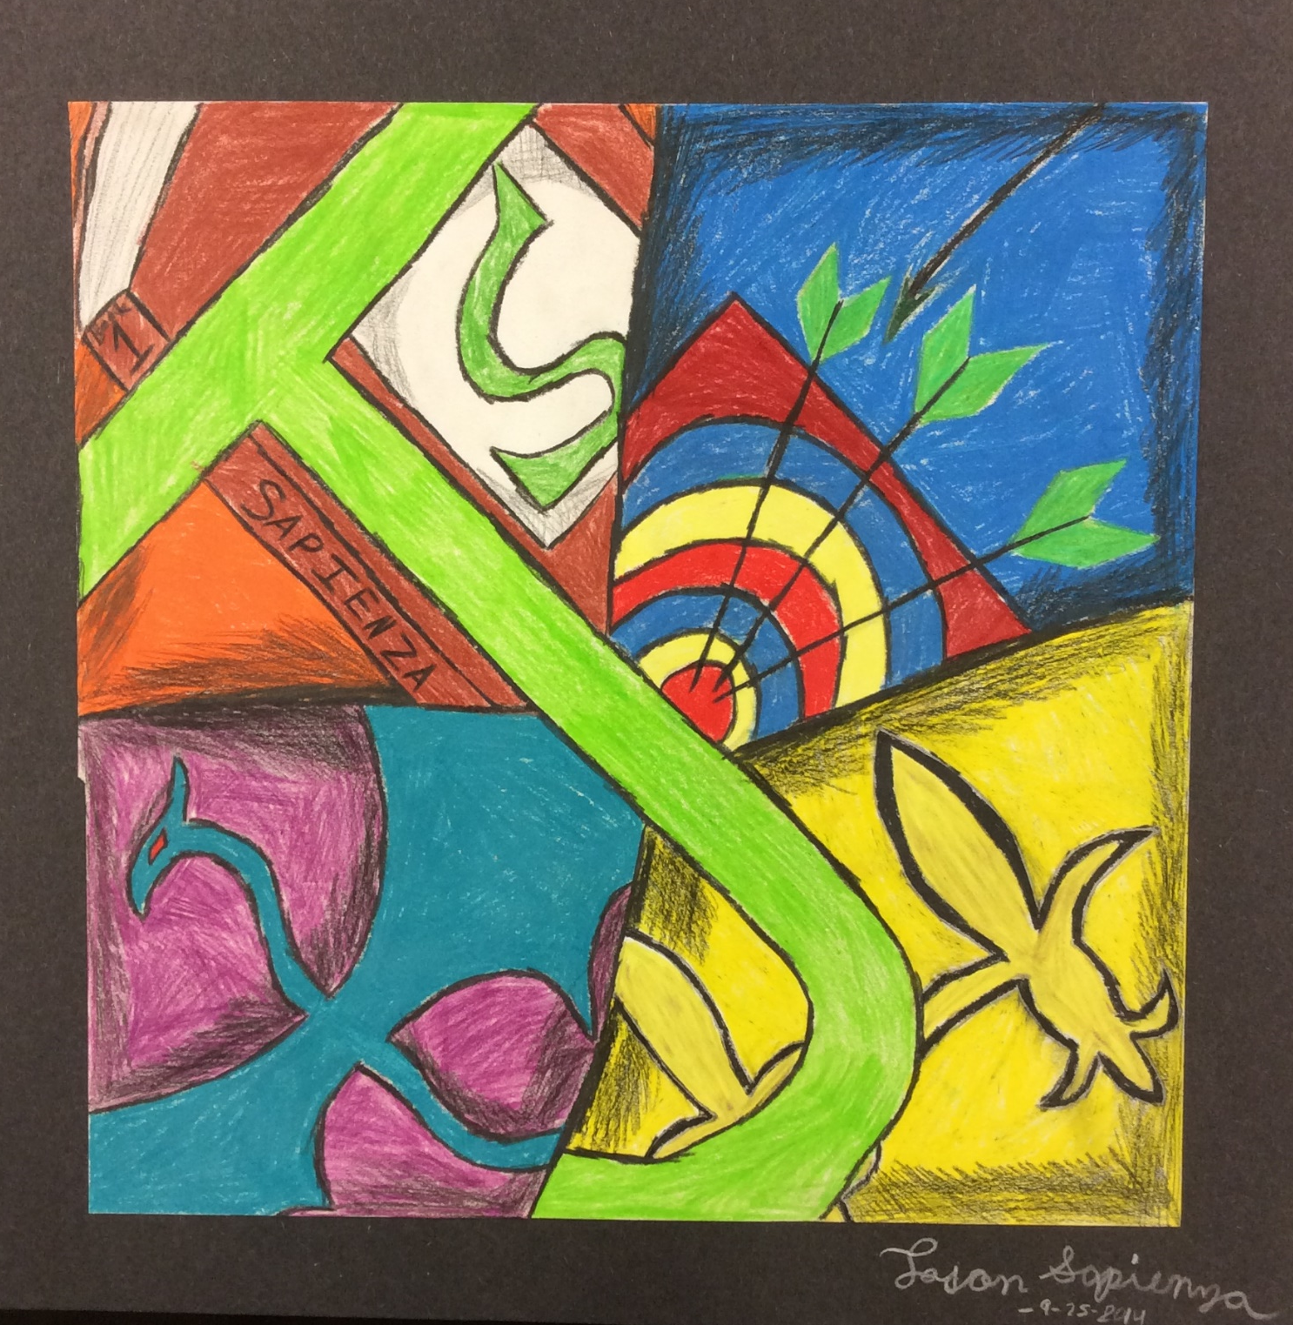

Slide 25
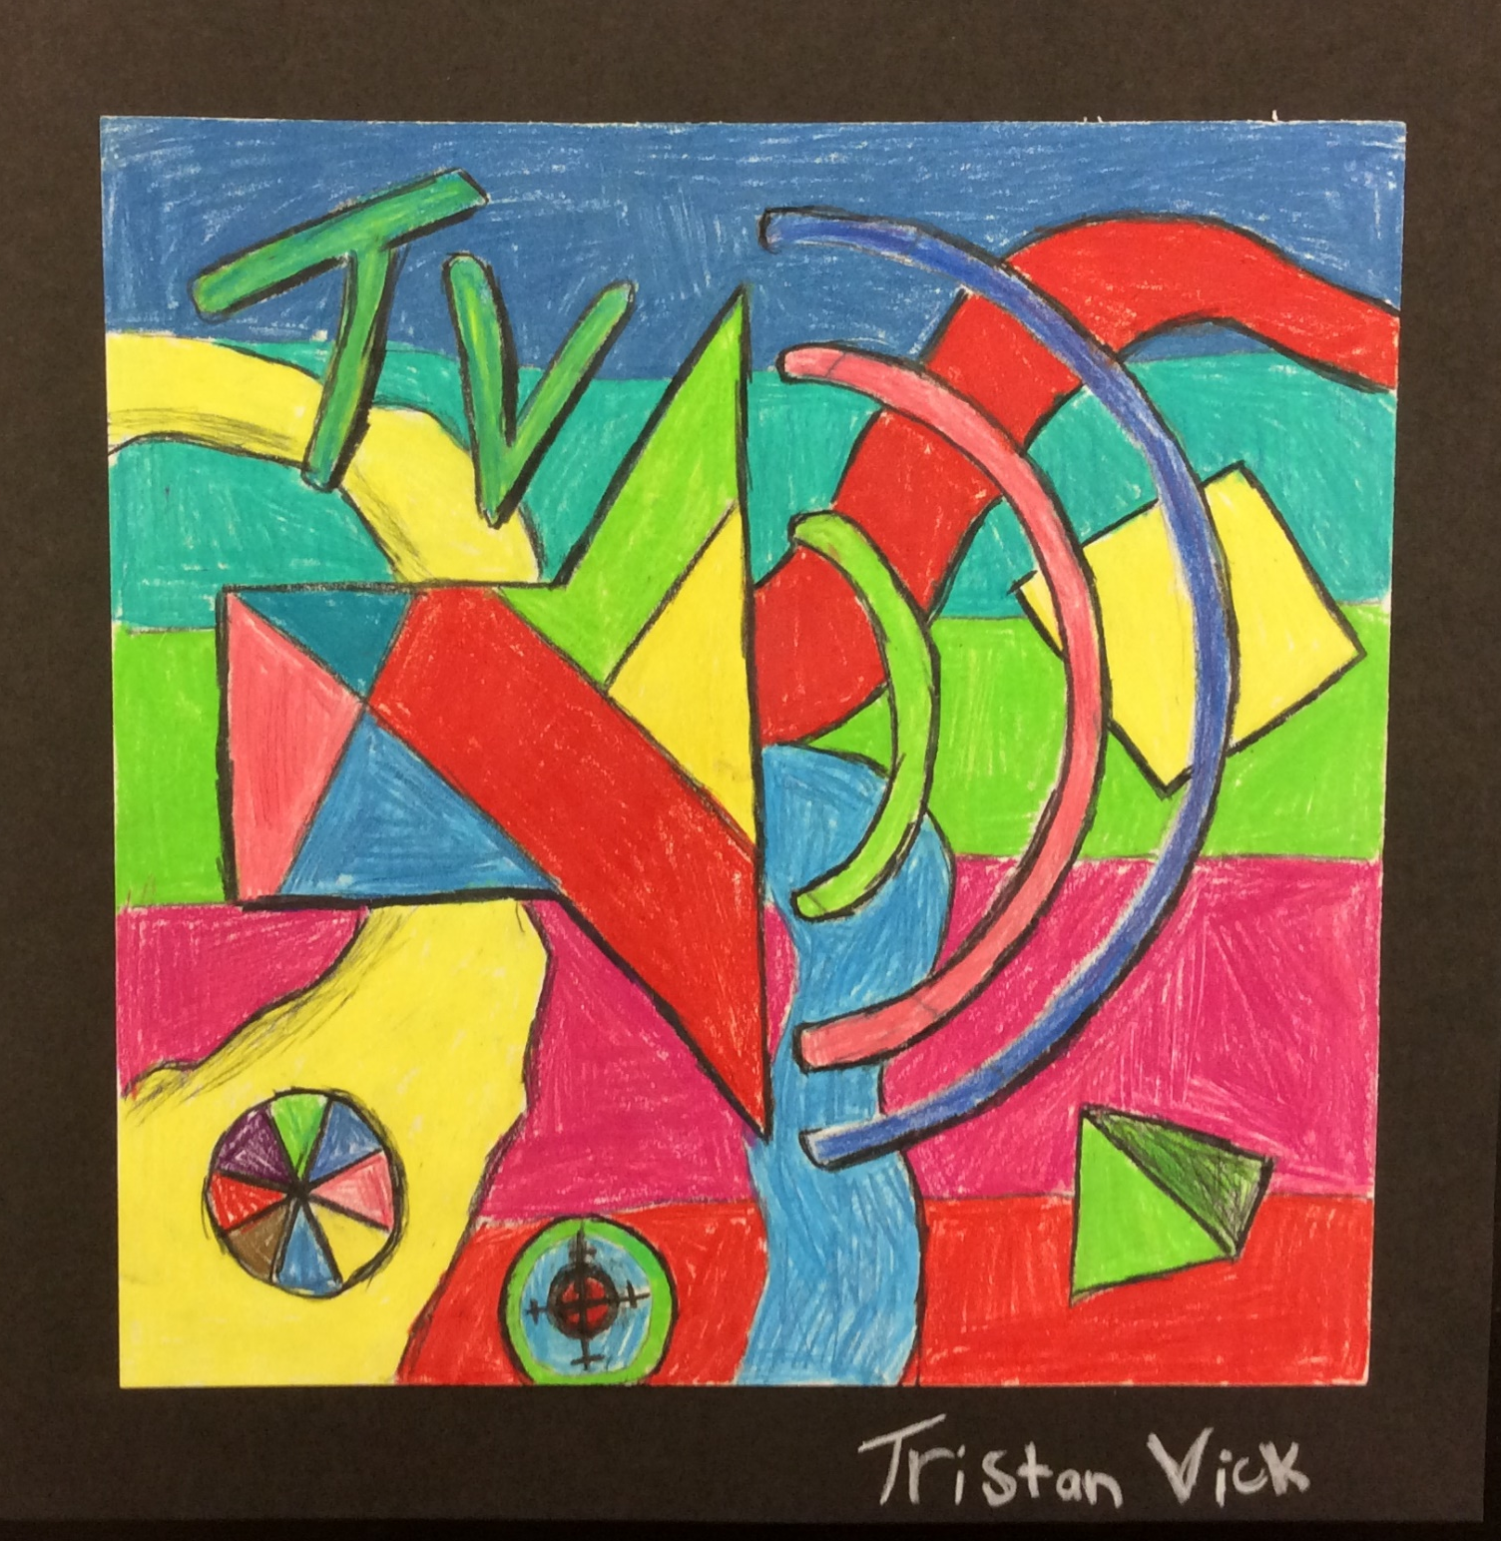

Slide 26
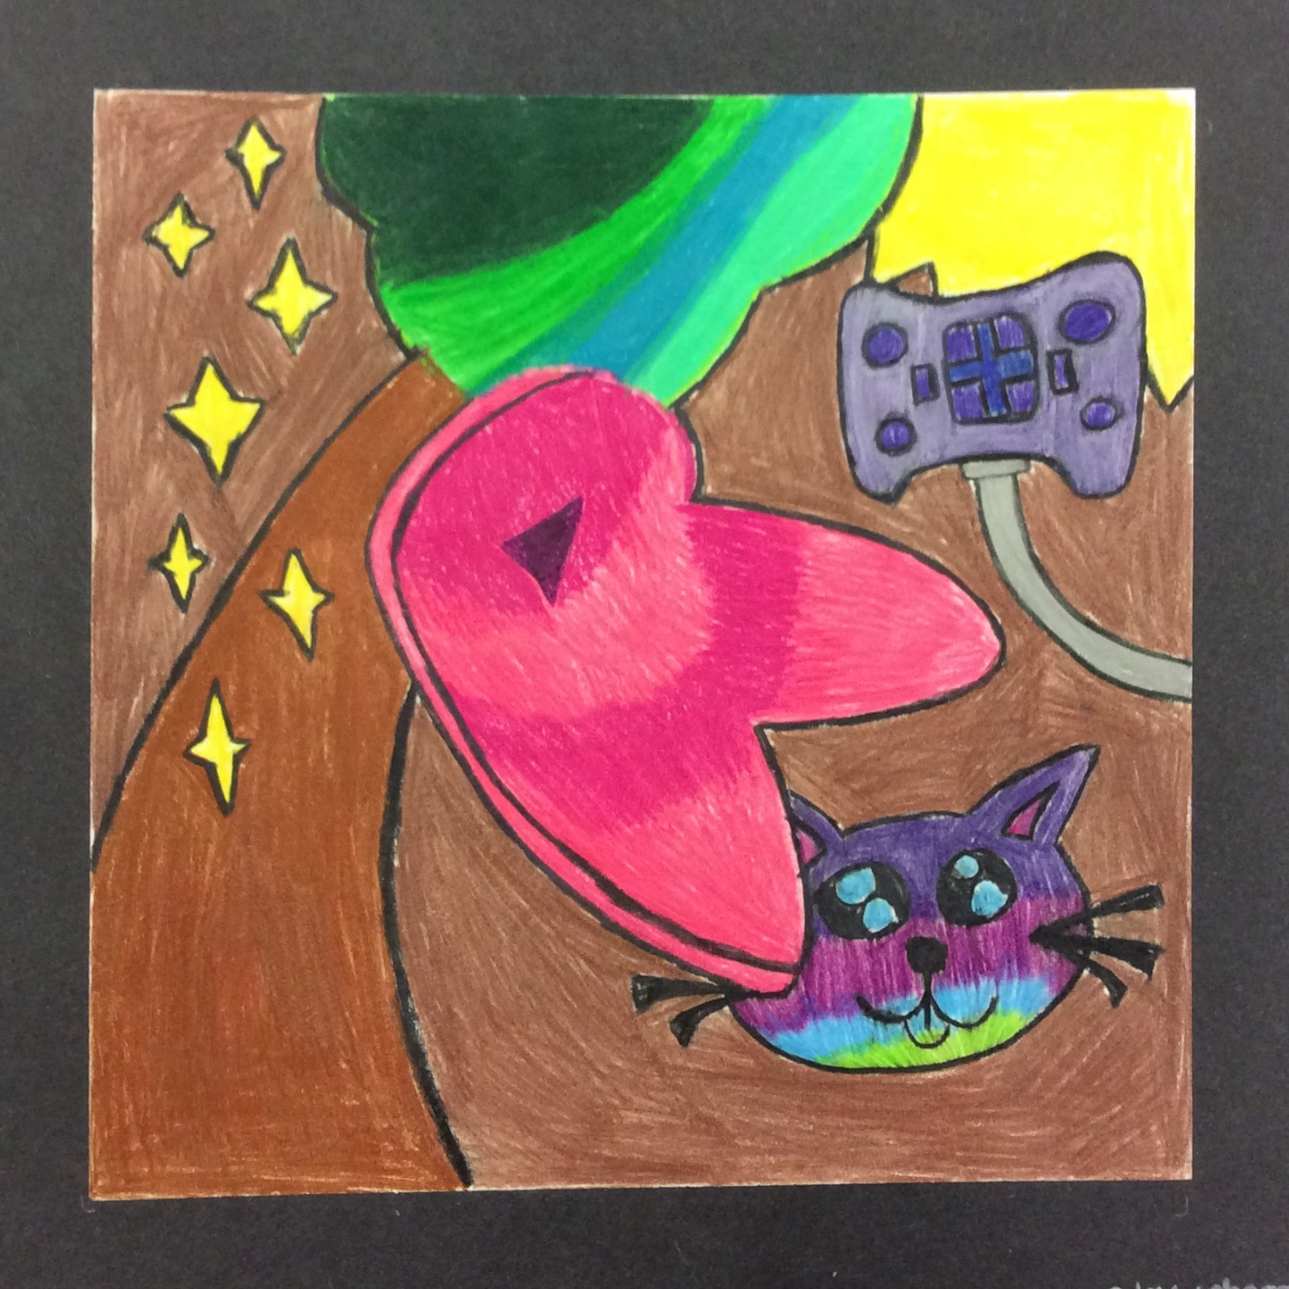

Slide 28
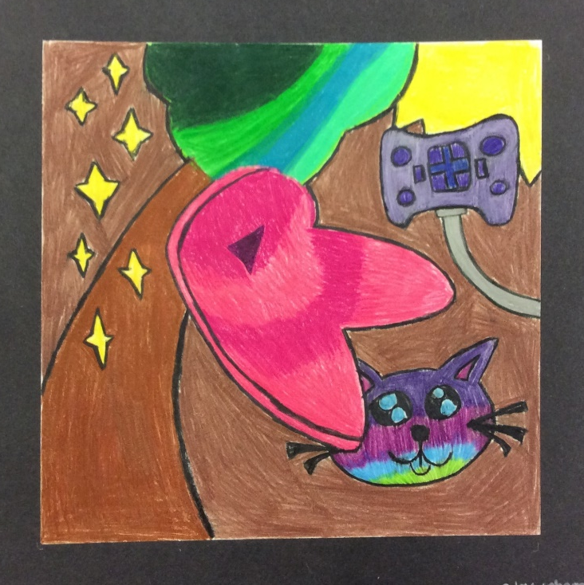
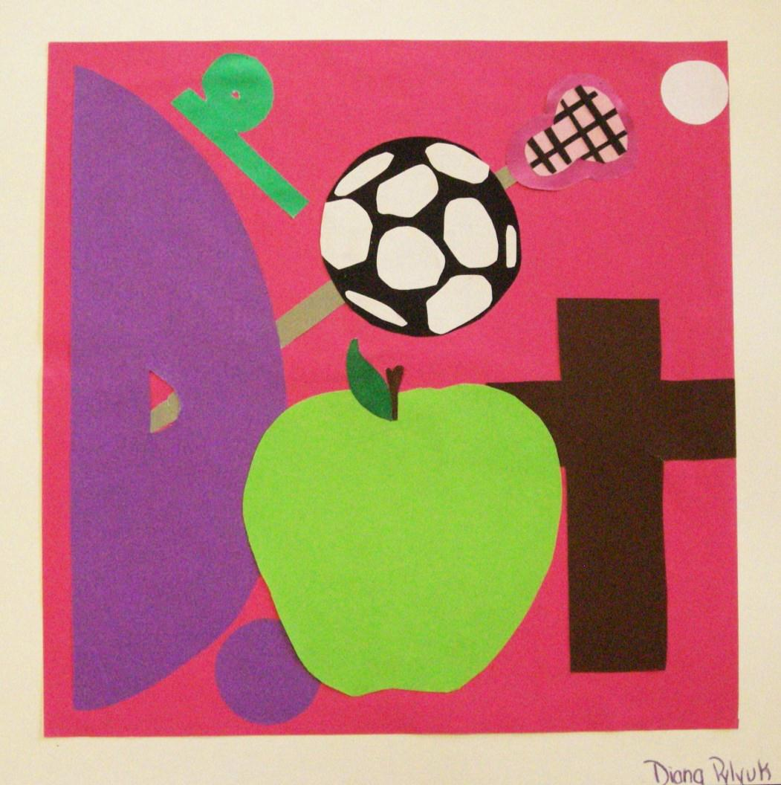

Slide 30
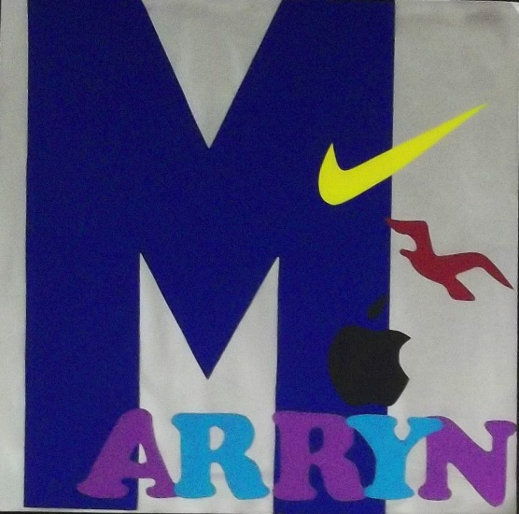

Slide 31
STEPS FOR YOUR Poster Portrait:
Come up with Symbols/icons/elements and text for your “Self Portrait”
– Things about you, games you like, school, sports, food, clothes, places you’ve been, family, pets, favorite: color, TV show, movie, band/singer/song, etc.
- List 4-5 of them on your thumbnail page and draw each once on a blank sheet of your sketchbook, for practice. Think BASIC, simple symbols.
2) 4 Thumbnails on the “Thumbnail Page”
– 4 different ideas using your symbols – MUST HAVE 4 DIFFERENT
EACH MUST HAVE: at least one symbol, at least one letter from your initials (BUT you can use your first/last/full name if you like!), at least 1-2 more shapes/elements
- Elements/shapes/lines/patterns can repeat!! You can have 1 bird, or 7 birds, or 17!
3) Draw lightly: Put your chosen composition on the white paper
4) COLOR! Using colored pencils we add value and color mixing!
REMEMBER: Your composition MUST have at least one letter/initial or your name, at least 1-2 symbols, and at least 1-2 added symbols or shapes or other design element

Slide 32
NOTES: OBJECTIVE B
“Work” = composition artwork
“Skills/Principles” = materials, balance/unity/emphasis/contrast
“Preliminary Work” = practice example(s) or thumbnails
Objective B: Developing Skills
Achievement Level | Level Descriptor | Student Grade | Final Grade | Indicators
0 | The student does not reach a standard described by any of the descriptors below
1-2 | The student: i. demonstrates limited acquisition and development of the skills and techniques of the art form studied ii. demonstrates limited application of skills and techniques to create, perform and/or present art. |  |  | Work is careless/does not reflect research. Improvement of skills/principles from the pre-asssesment is not evident or improved upon Work is carelessly smudged/dirty/damaged Student shows little to no use of individual instruction/exploration. Preliminary work was not completed.
3-4 | The student: i. demonstrates adequate acquisition and development of the skills and techniques of the art form studied ii. demonstrates adequate application of skills and techniques to create, perform and/or present art |  |  | Work is a sufficient reflection of the source/research. Improvement of skills/principles from the pre-assessment is sufficiently evident Work should be cleaner or repaired. Student shows a portion of individual instruction/exploration. Preliminary work was partially completed.

Slide 33
NOTES: OBJECTIVE B
“Work” = composition artwork
“Skills/Principles” = materials, balance/unity/emphasis/contrast
“Preliminary Work” = practice example(s) or thumbnails
Objective B: Developing Skills
Achievement Level | Level Descriptor | Student Grade | Final Grade | Indicators
5-6 | The student: i. demonstrates substantial acquisition and development of the skills and techniques of the art form studied ii. demonstrates substantial application of skills and techniques to create, perform and/or present art. |  |  | Elements reflect the source/research. Improvement of skills/principles from the pre-asssesment is clearly in use. Work has minor un-necessary smudging or creasing/damage. Student shows use of individual instruction/exploration. Preliminary work and ideas were varied and mostly completed.
7-8 | The student: i. demonstrates excellent acquisition and development of the skills and techniques of the art form studied ii. demonstrates excellent application of skills and techniques to create, perform and/or present art. |  |  | Elements clearly reflect the source/ imagery/ research, and are improved (pre-tests etc.) Improvement of skills/principles from the pre-assessment is very evident. Work is clean and well presented. Student shows use of individual instruction/exploration. Preliminary work and ideas were fully elaborated and completed

Slide 34
NOTES: OBJECT IVE C
“Work” = Composition process artwork
“Skills/Principles” = Materials, balance/unity/emphasis/contrast
“Preliminary Work” = practice example(s), drawings, or thumbnails
Objective C: Thinking Creatively
Achievement Level | Level Descriptor | Student Grade | Final Grade | Indicators
0 | The student does not reach a standard described by any of the descriptors below
1-2 | The student: i. presents a limited outline of an artistic intention, which may lack clarity or feasibility ii. presents a limited outline of alternatives, perspectives, and imaginative solutions iii. demonstrates limited exploration of ideas through the developmental process, which may lack a point of realization.. |  |  | Skills/Principles are weak or ignored. Work is carelessly messy/dirty/damaged Preliminary work was not completed.
3-4 | The student: i. presents an adequate outline of a clear and/or feasible artistic intention ii. presents an adequate outline of alternatives, perspectives, and imaginative solutions iii. demonstrates adequate exploration of ideas through the developmental process to a point of realization |  |  | Required skills/principles are developing Work should be cleaner or repaired. Preliminary/practice sketches are limited Required amount of preliminary/practice sketches or ideas are not completed and/or are not developed

Slide 35
NOTES: OBJECT IVE C
“Work” = Composition process artwork
“Skills/Principles” = Materials, balance/unity/emphasis/contrast
“Preliminary Work” = practice example(s), drawings, or thumbnails
Objective C: Thinking Creatively
Achievement Level | Level Descriptor | Student Grade | Final Grade | Indicators
5-6 | The student: i. presents a substantial outline of a clear and feasible artistic intention ii. presents a substantial outline of alternatives, perspectives, and imaginative solutions iii. demonstrates substantial exploration of ideas through the developmental process to a point of realization. |  |  | Required skills/principles are clearly in use. Work has un-necessary messiness or is creased/damaged. Preliminary/practice sketches have some variety/ different ideas. Required amount of preliminary/practice sketches or ideas are completed and are adequately developed
7-8 | The student: i. presents an excellent outline of a clear and feasible artistic intention ii. presents an excellent outline of alternatives, perspectives, and imaginative solutions iii. demonstrates excellent exploration of ideas through the developmental process to a point of realization. |  |  | Required skills/principles are very evident. Work is clean and well presented. Preliminary/practice sketches are fully elaborated and show a variety of different ideas. Required amount of preliminary/practice sketches or ideas are completed and are fully developed

