Slide 1
What you need for your Art Final Exam
8th Grade, Ms. Salatino

Slide 2
You will be graded on a series of activities we have done throughout the year.
You will be graded on:
Organization→ are all of your worksheets glued in neatly
Art History Overviews
Art Worksheets
Notes
Your Cubism Value Project
Your Form Still Life
Your Apple Painting

Slide 3
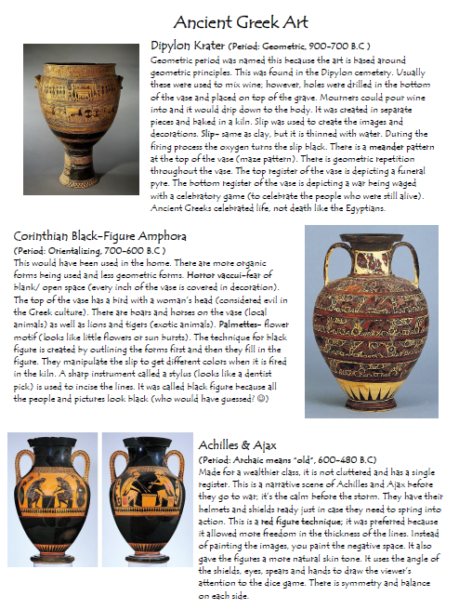
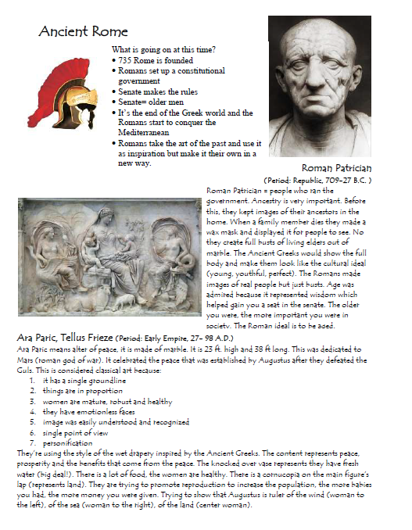
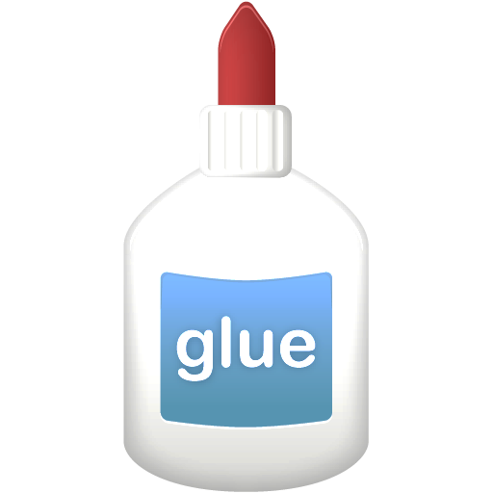
Glue In: Art History Worksheets

Slide 4
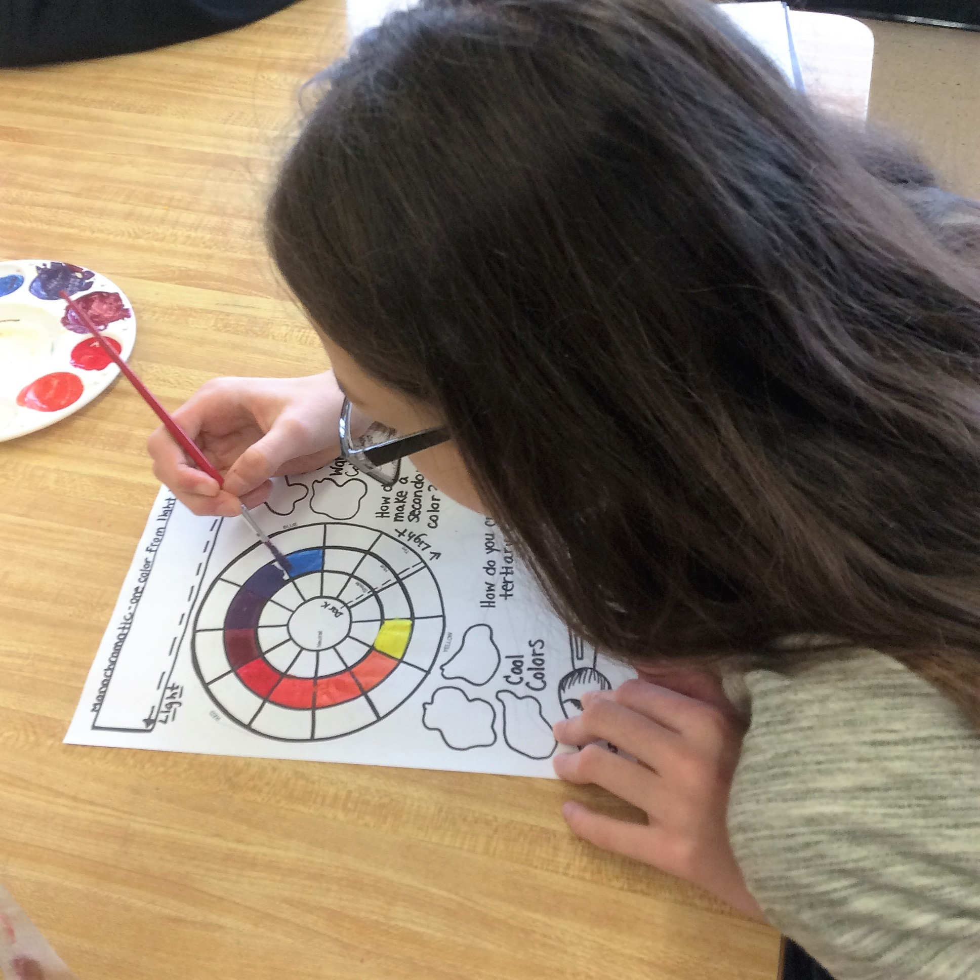
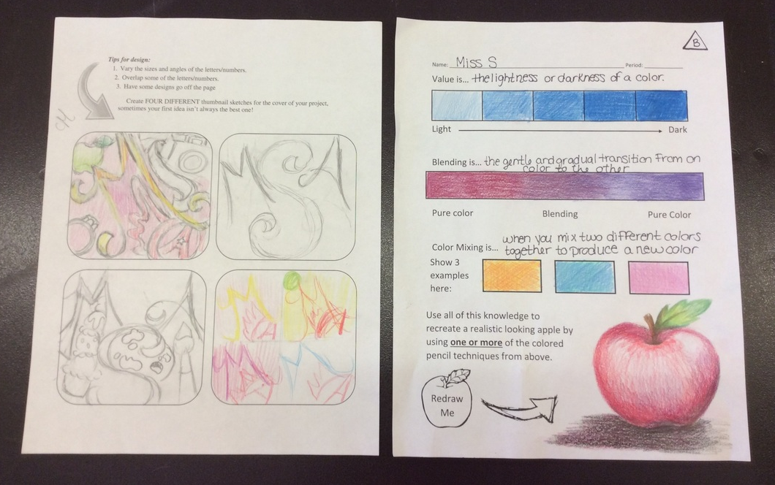
Glue In: Process Worksheets

Slide 5
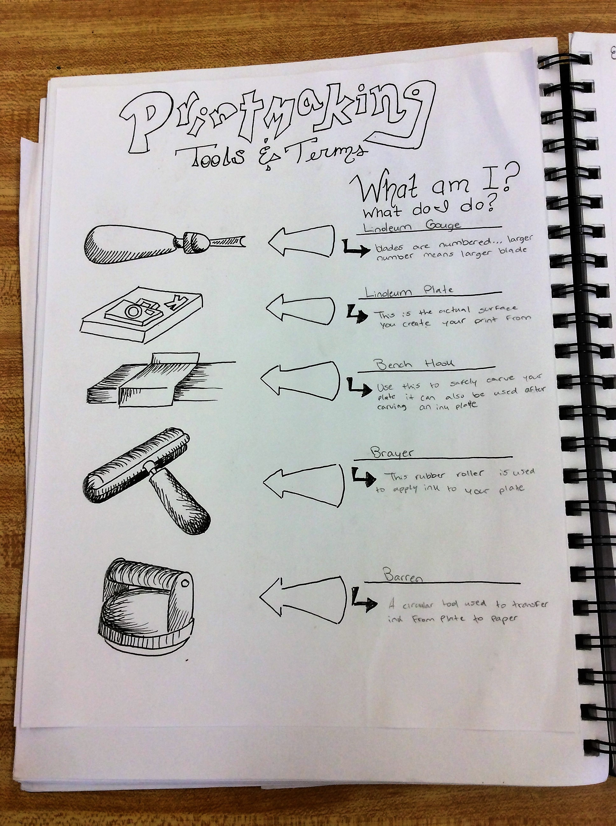
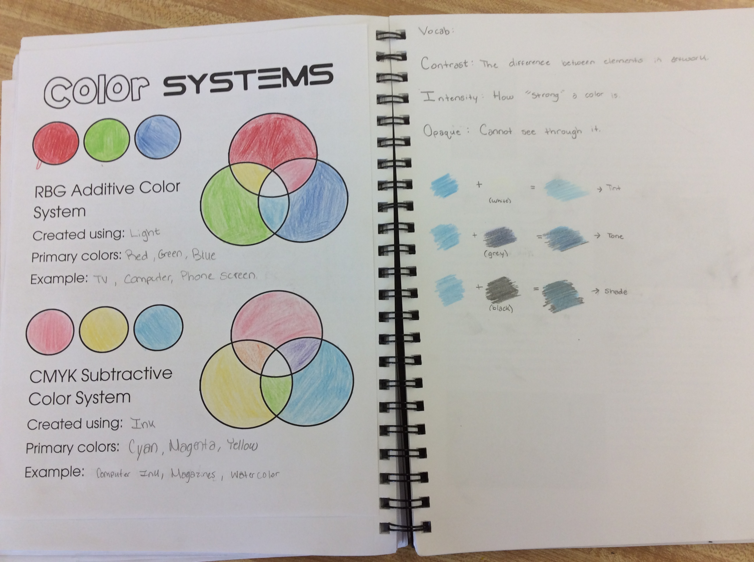
Glue In: Notes

Slide 6
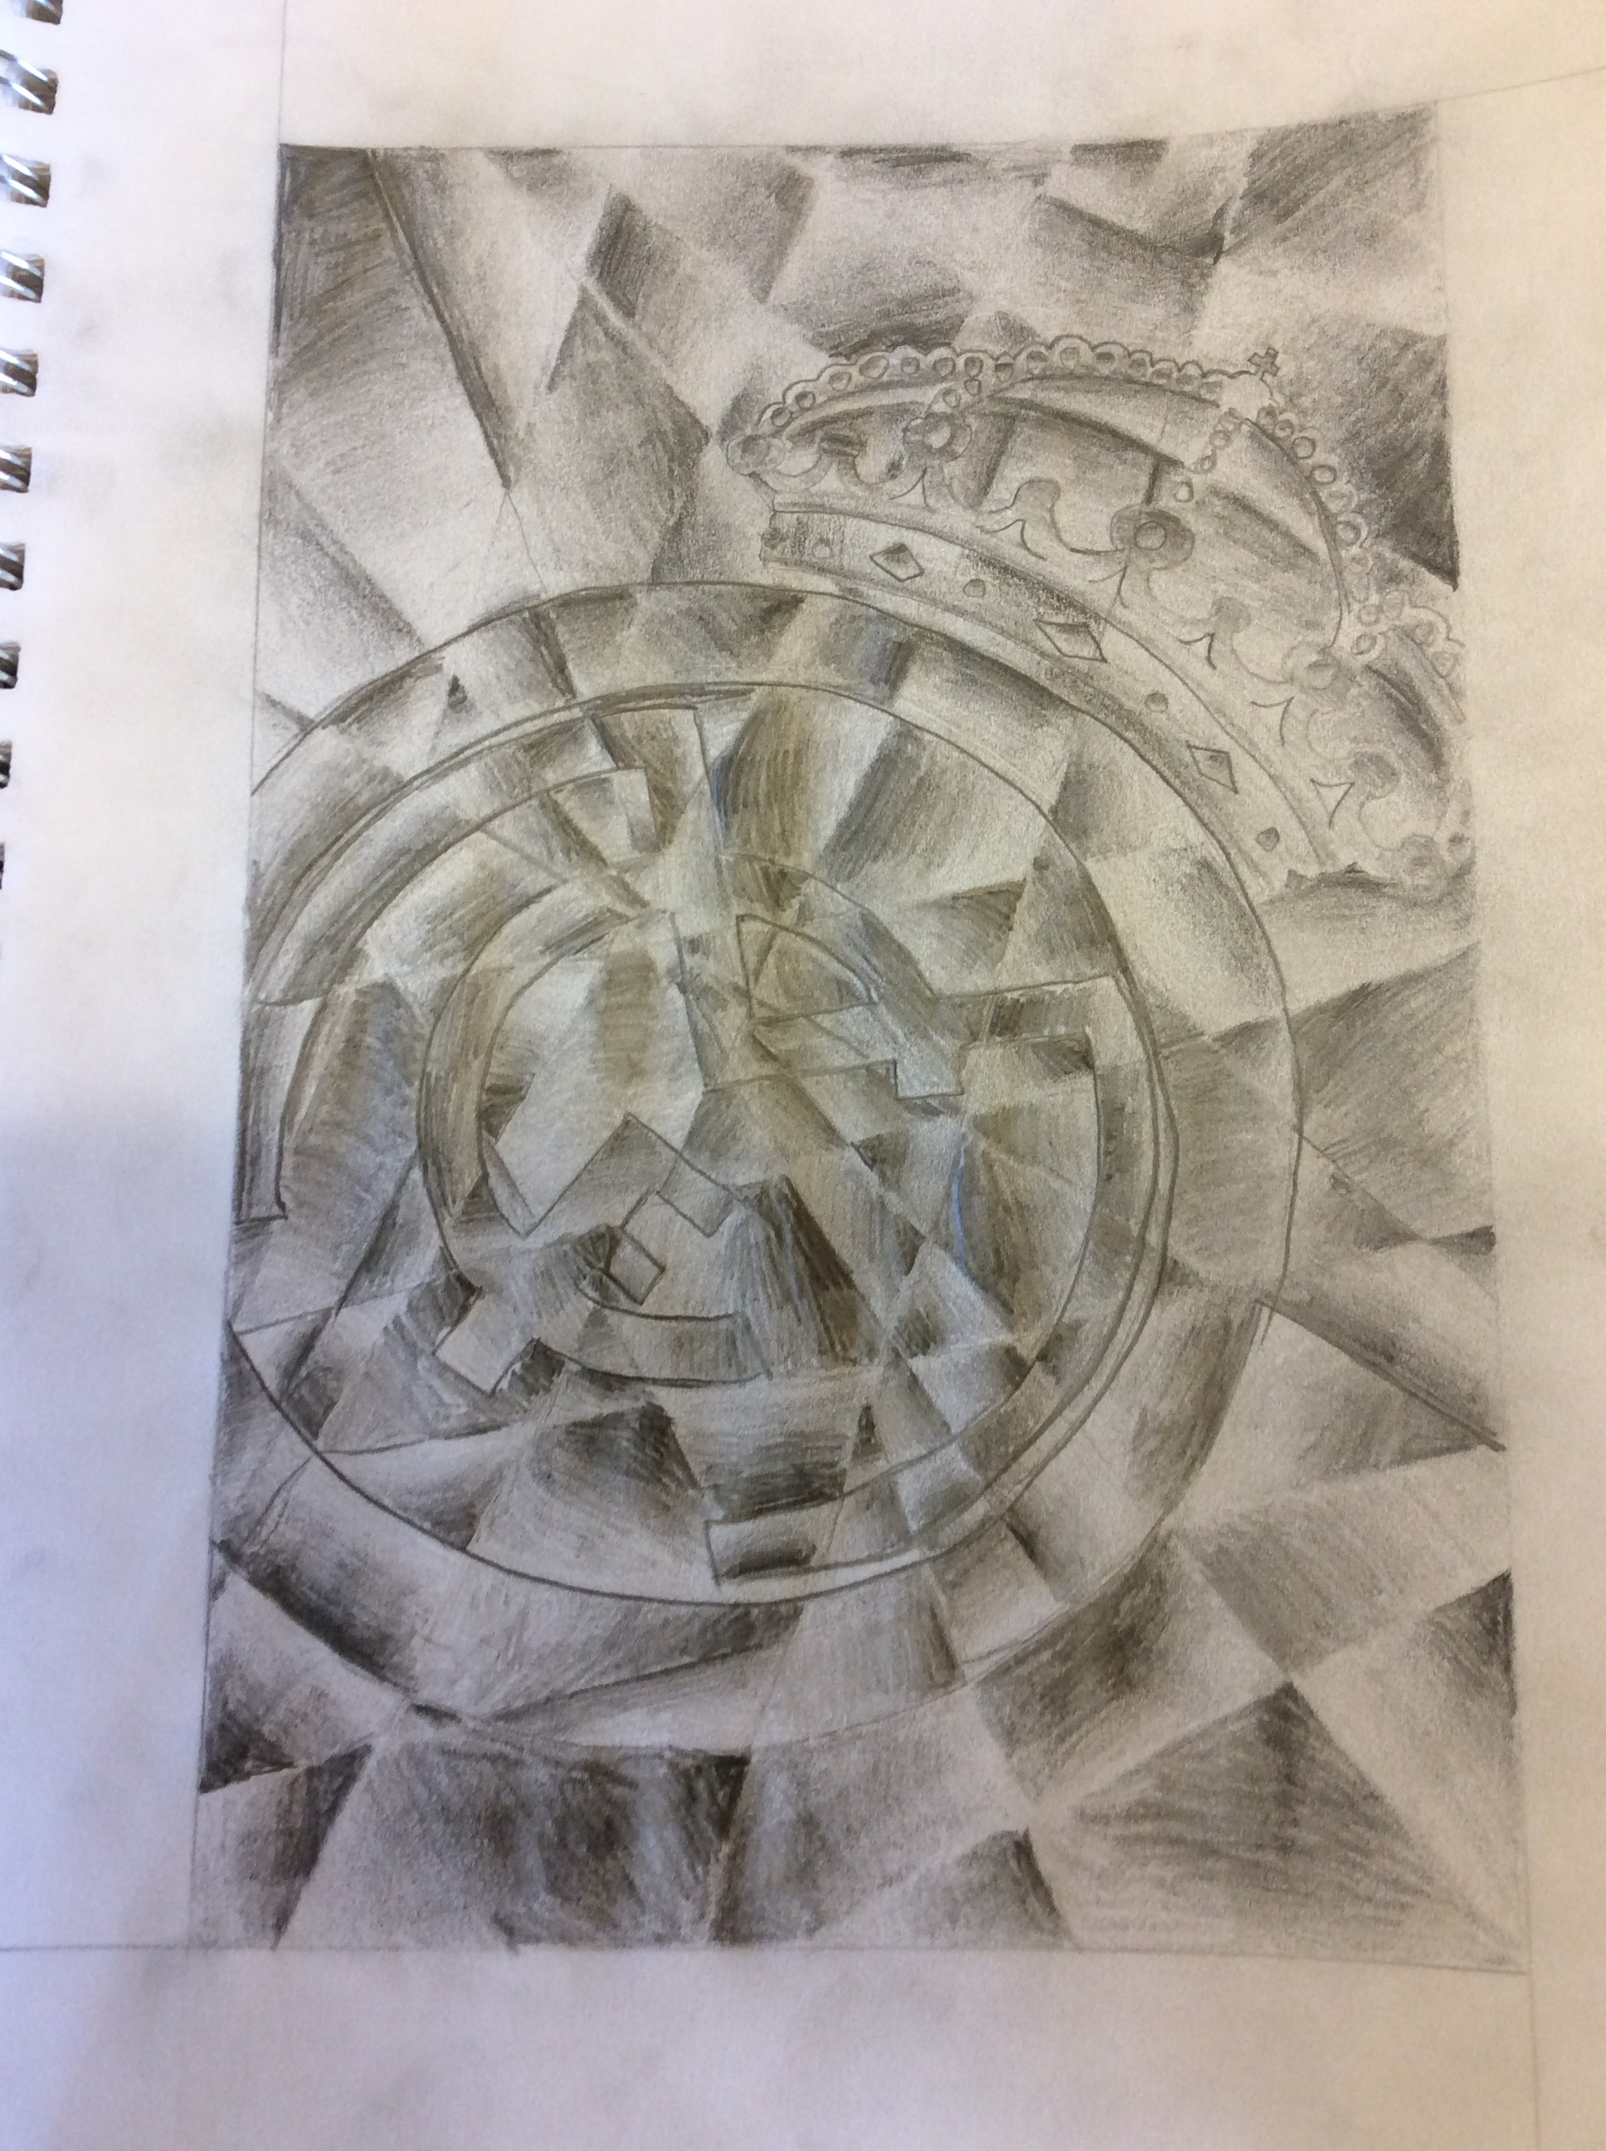
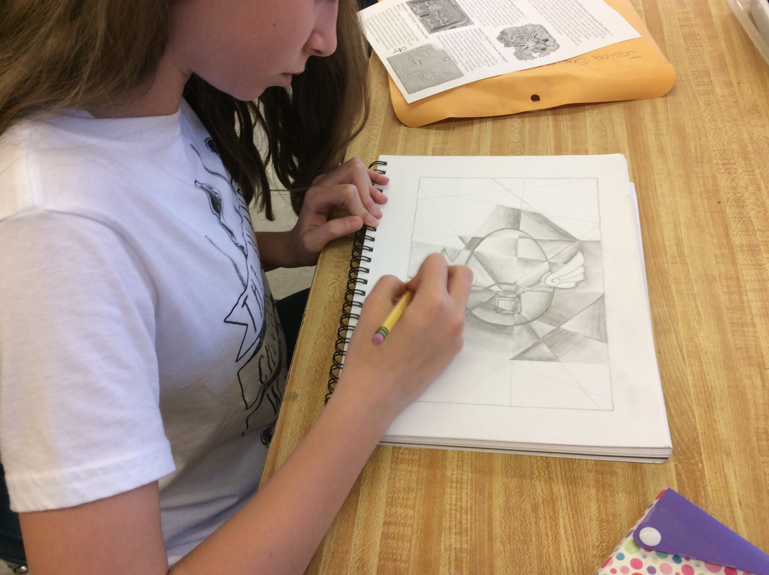
Complete: Cubism Value Assignment

Slide 7
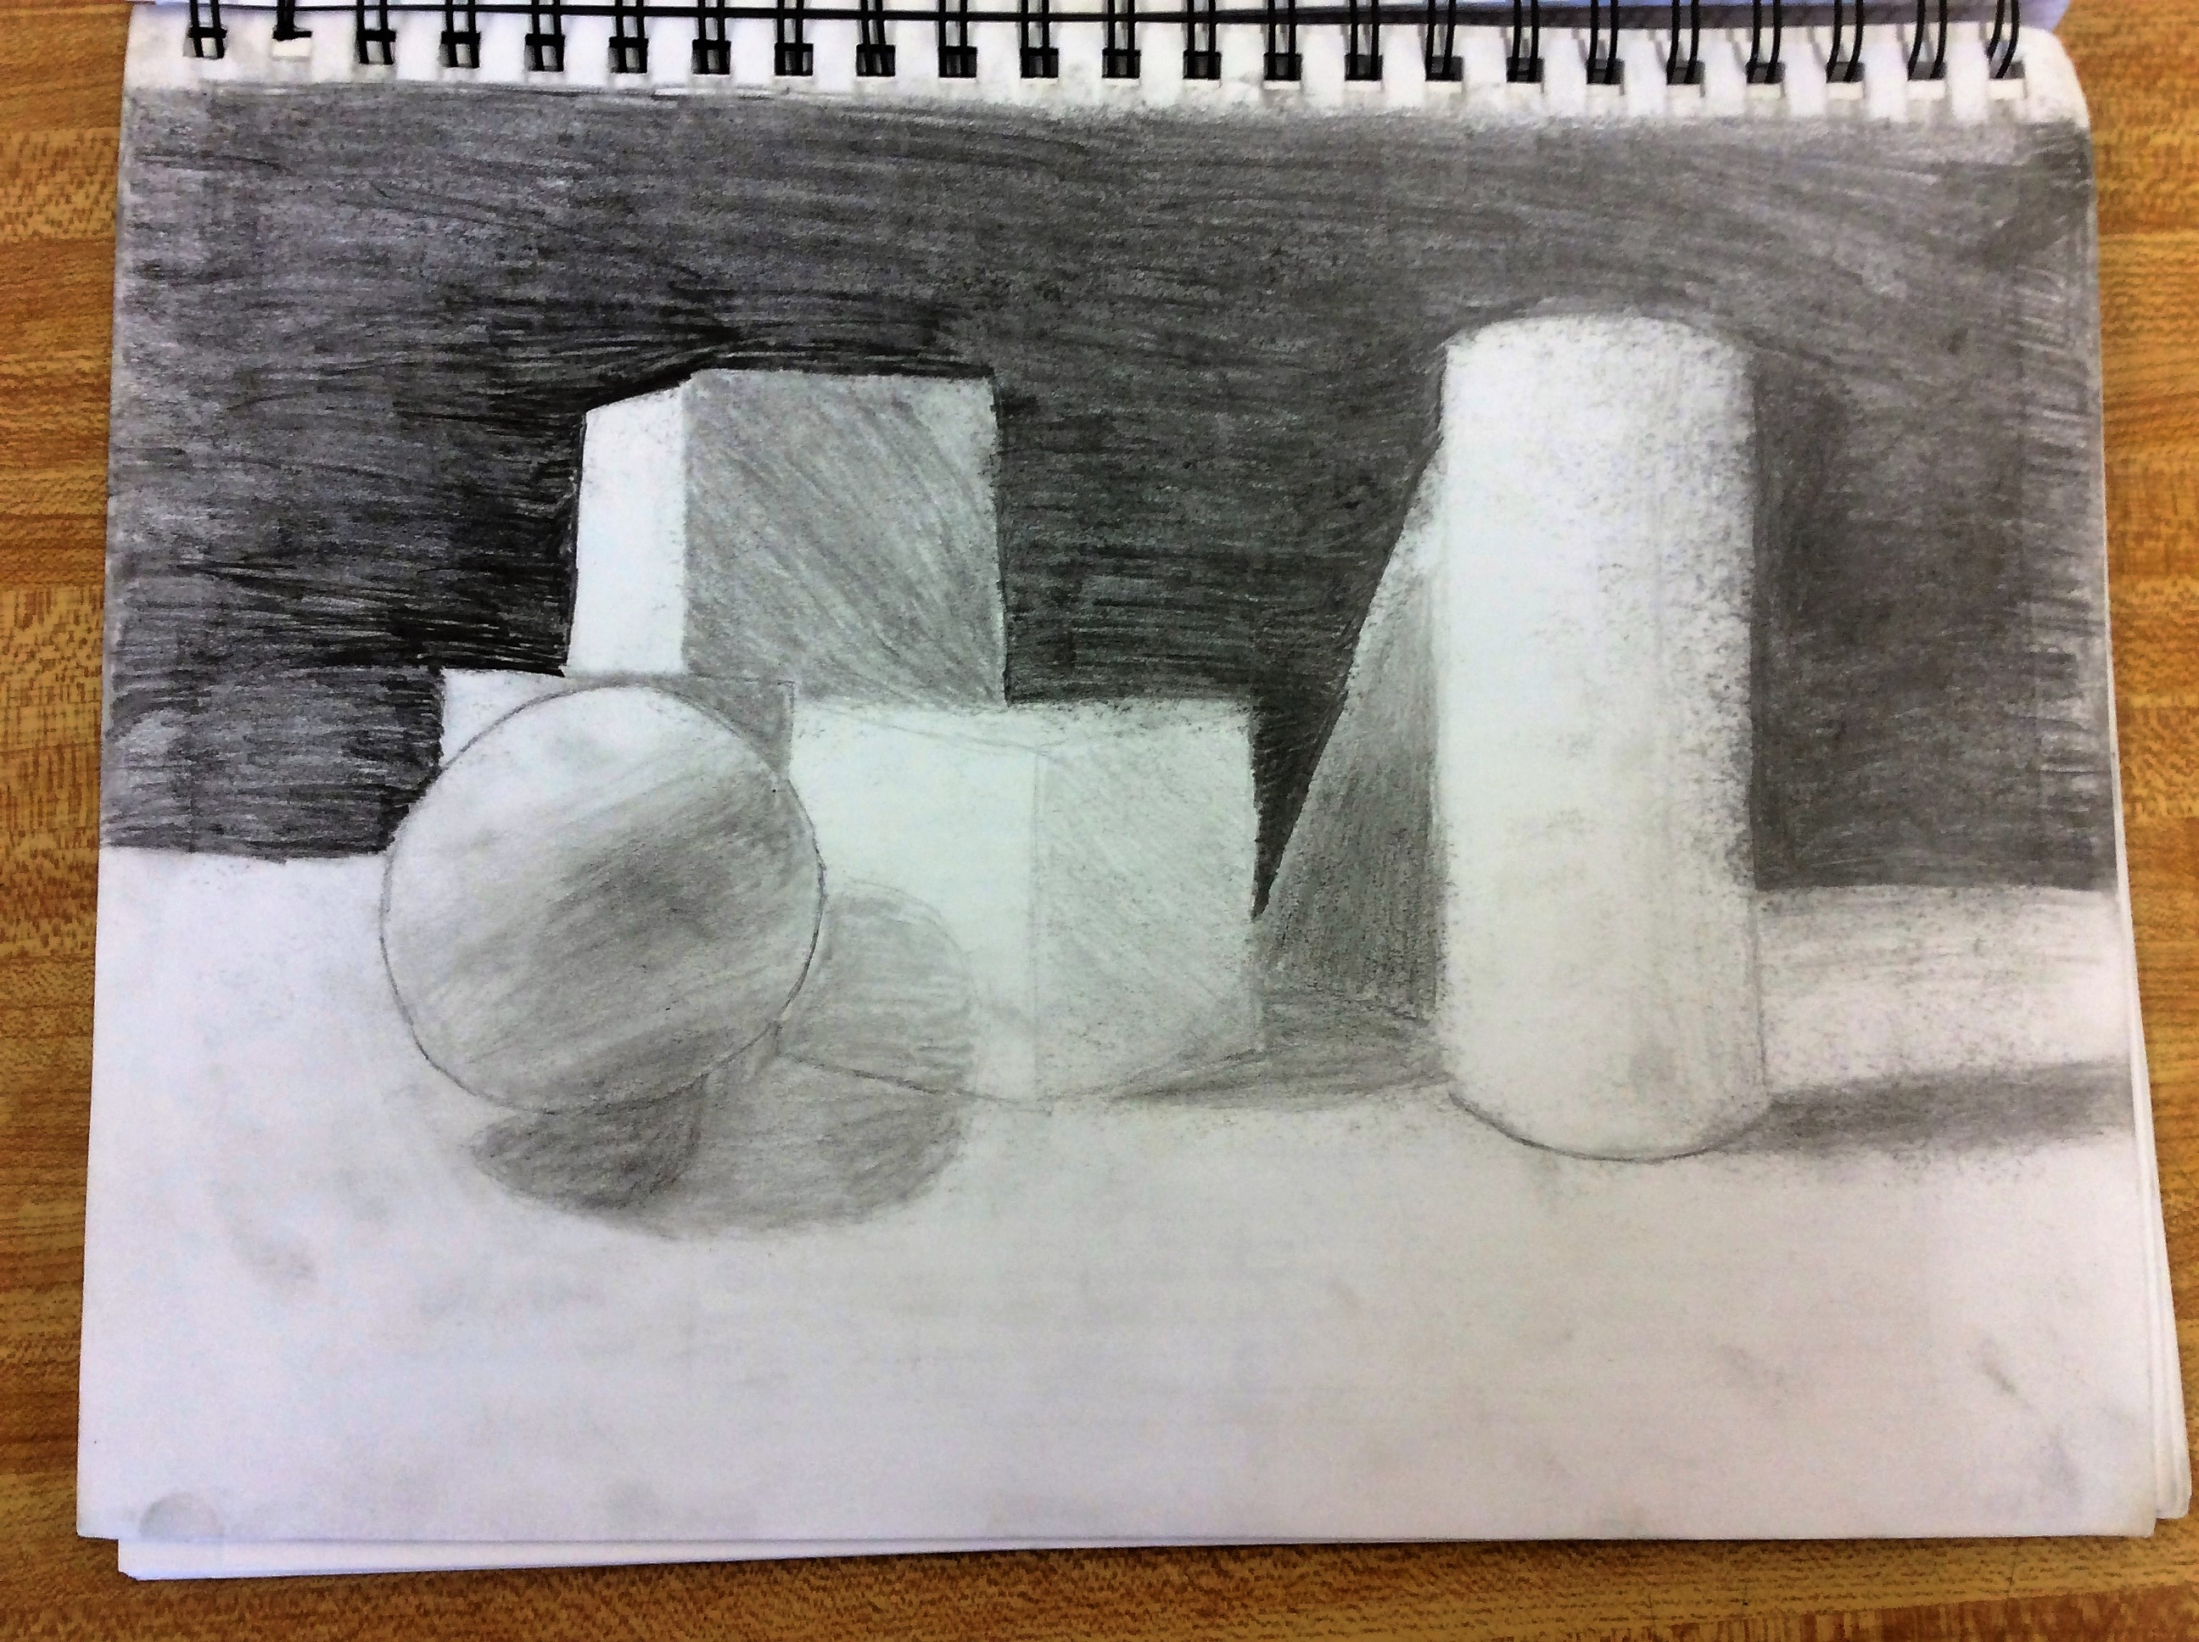
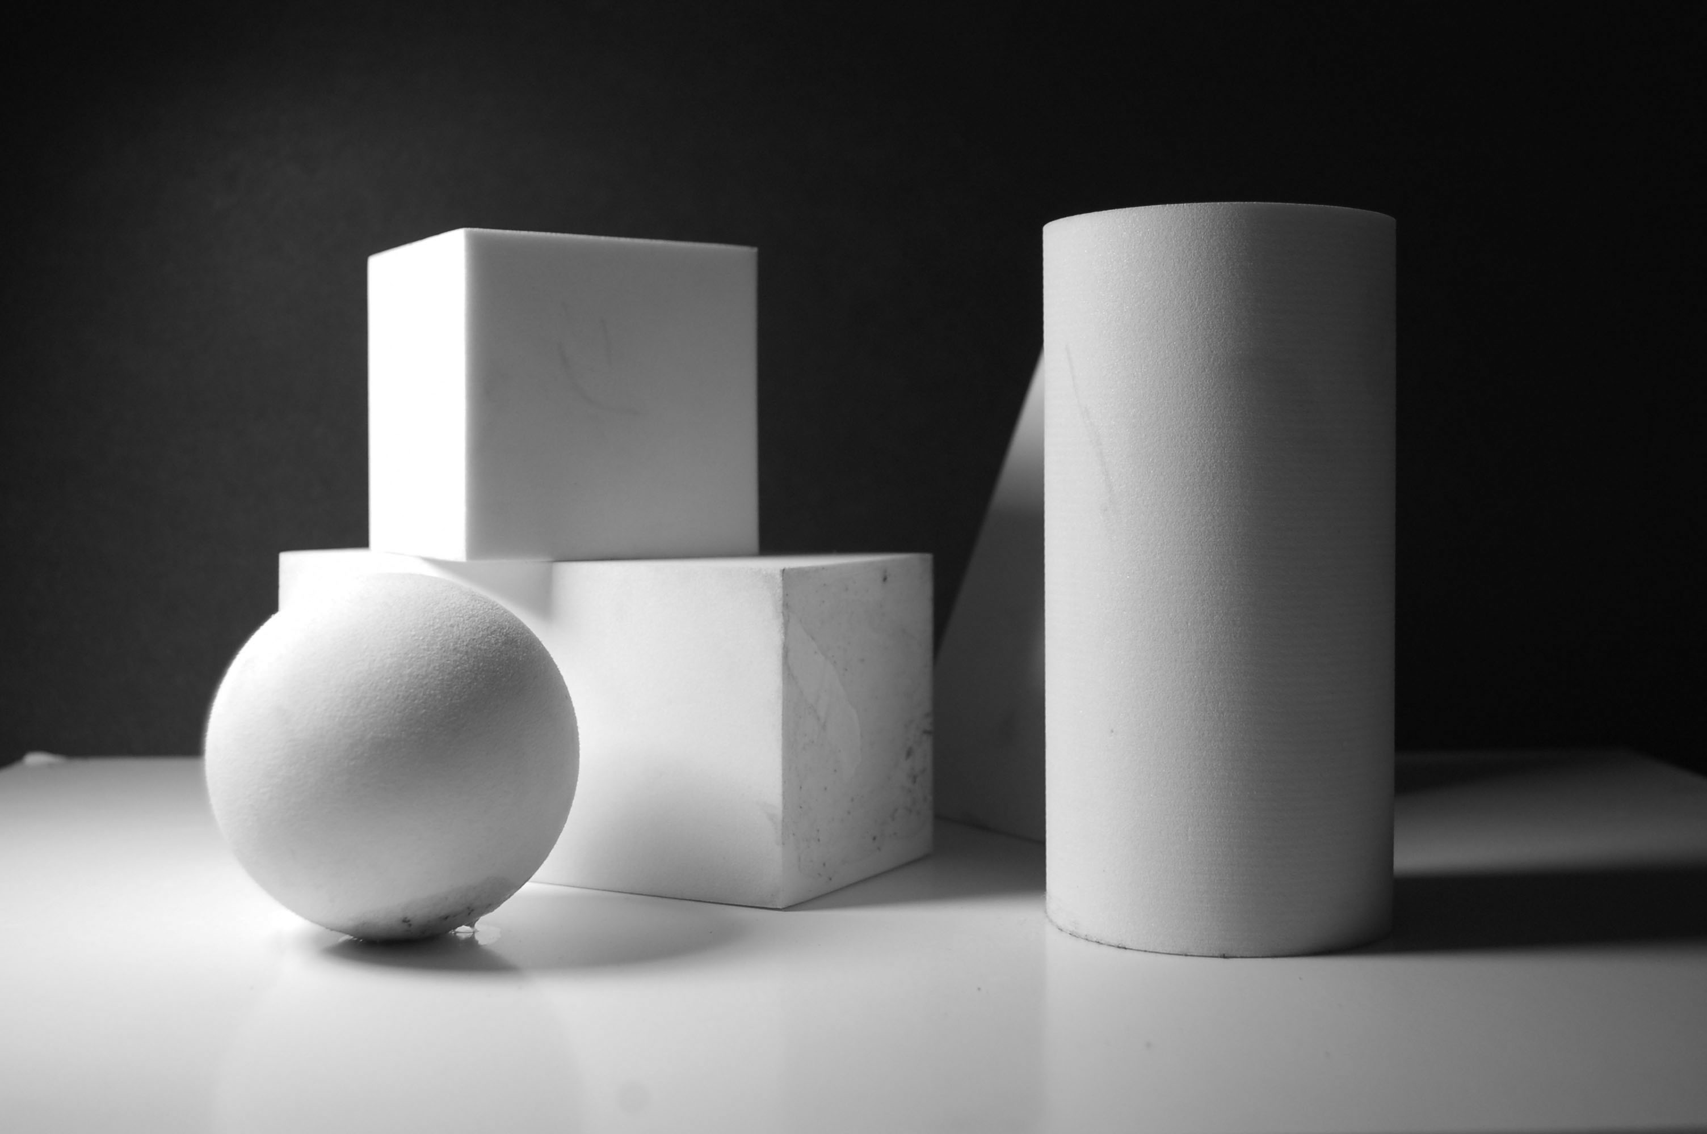
Complete: Form Value Assignment

Slide 8
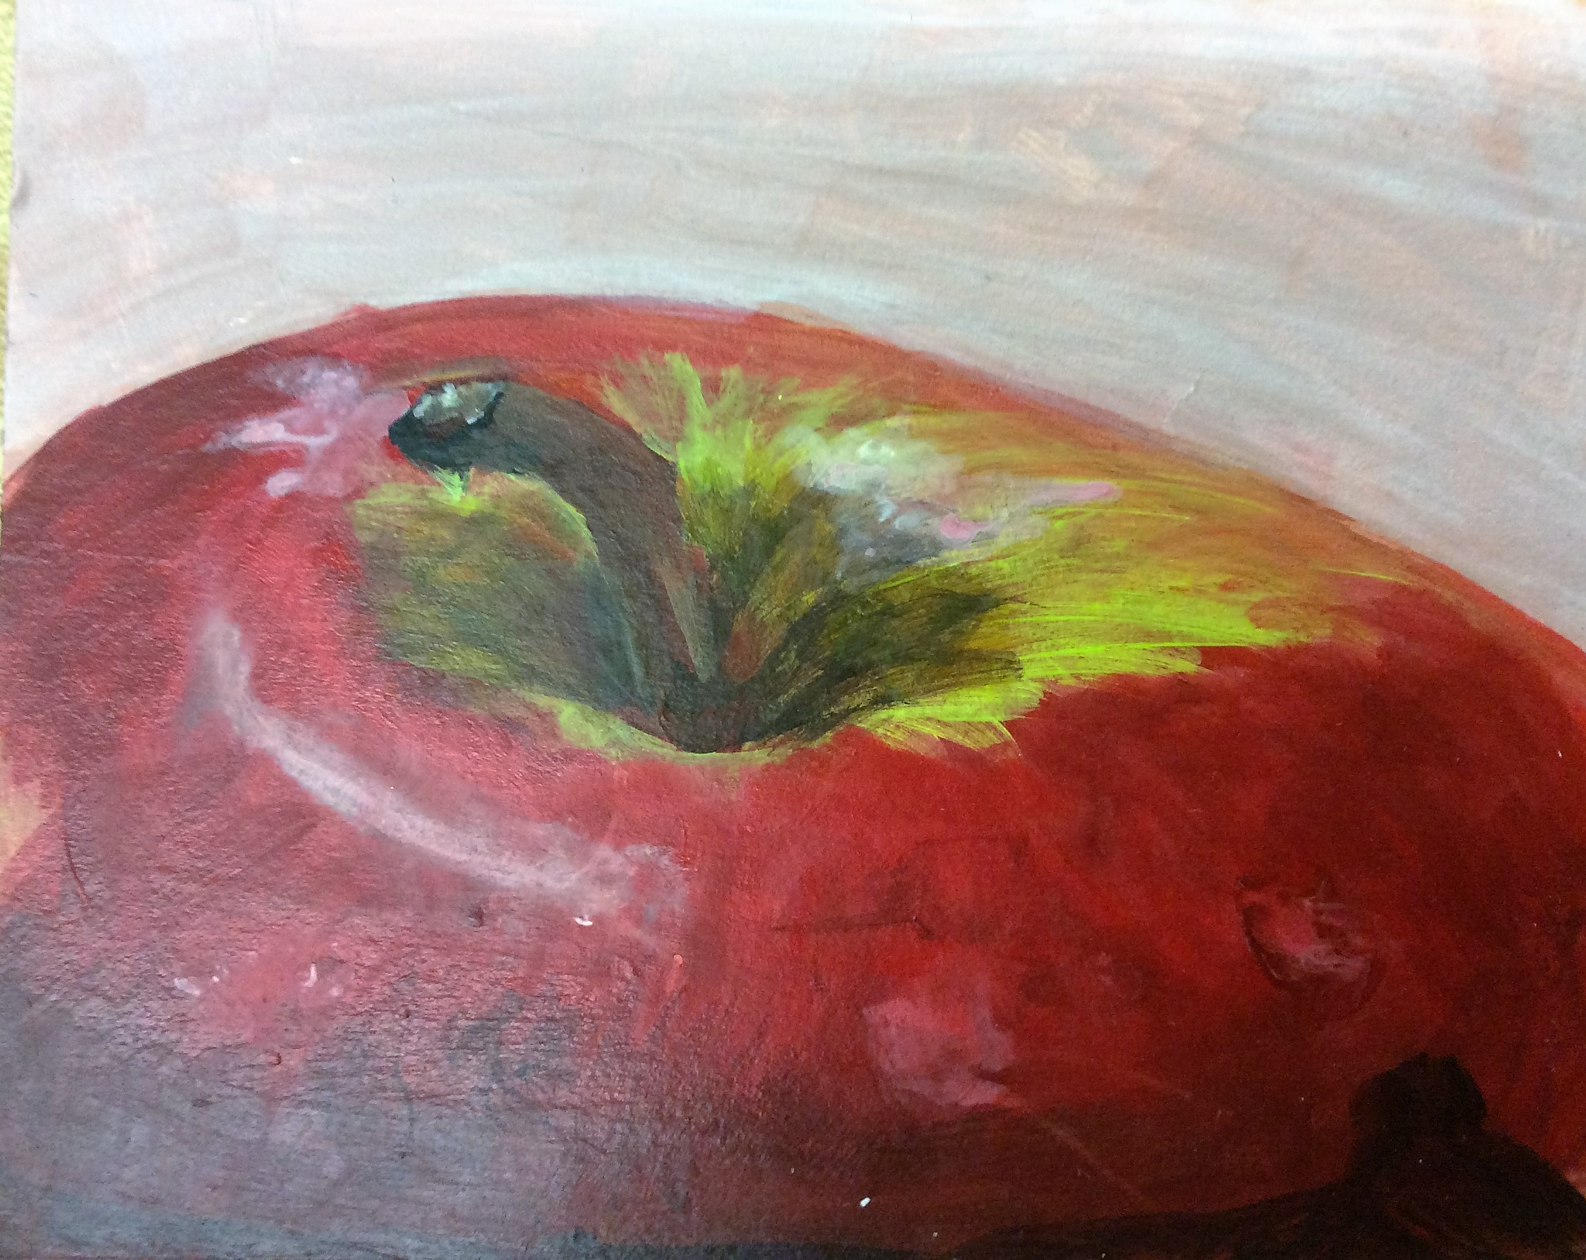
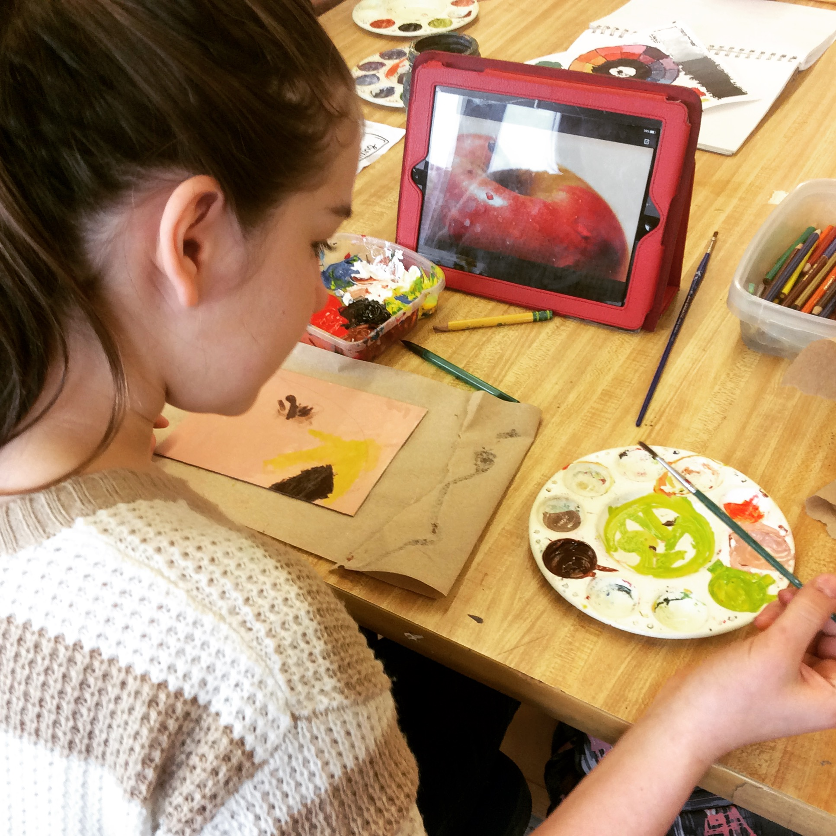
Complete: Apple Painting

Slide 9
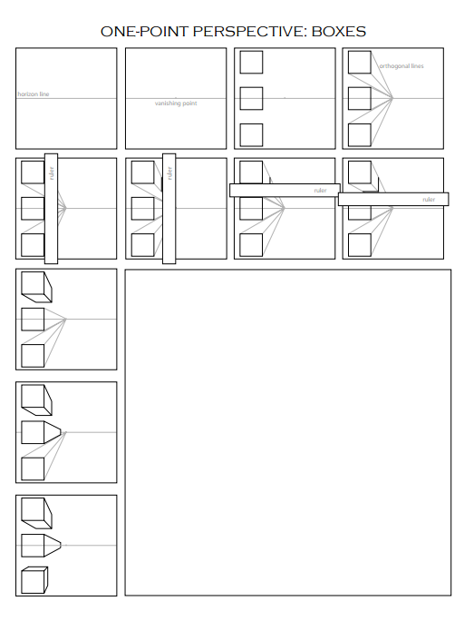
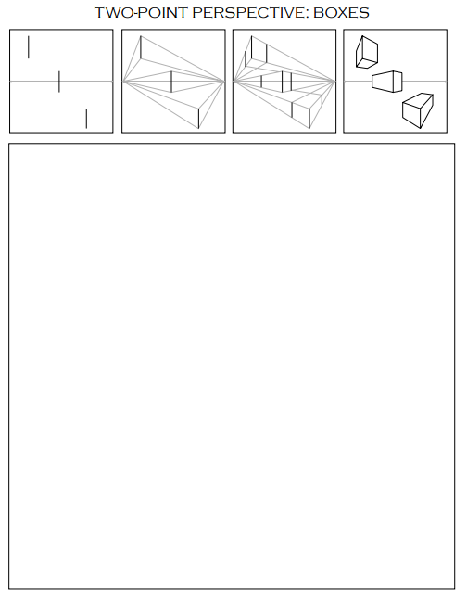
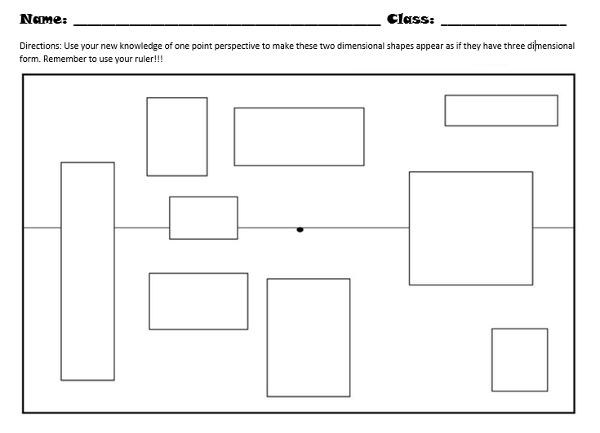
Complete: Perspective three Worksheets

