Slide 1
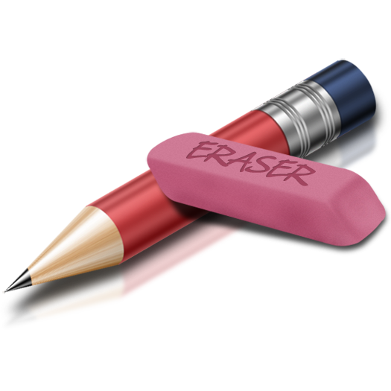
Composition
Demuth inspired sketchbook cover

Slide 2
COMPOSITION…?
What is it? Where have you heard this word before? Is it used in other classes?

Slide 3
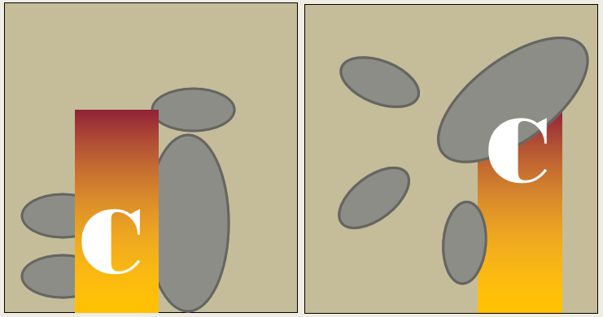
Composition: Arrangement of elements in art.

Slide 4
What are your thoughts on this composition? Is it interesting?

Slide 5
What about this composition?

Slide 6
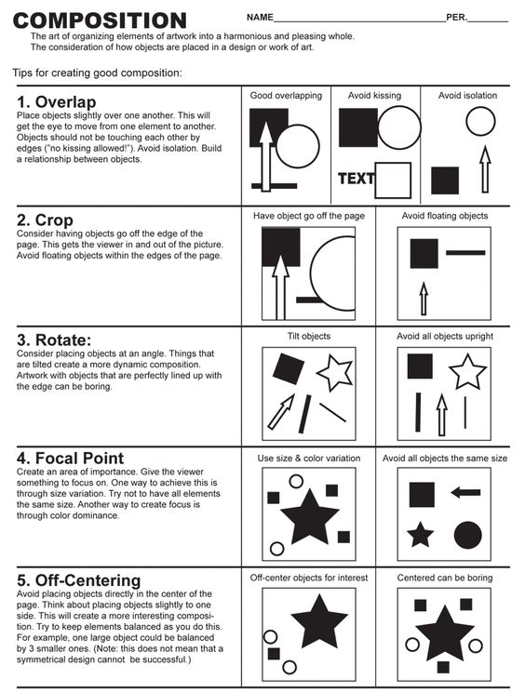
Rules of Composition

Slide 7
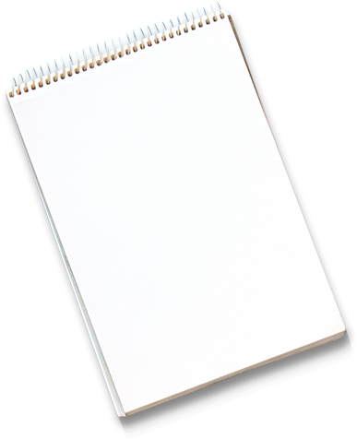
Let’s practice our composition skills.
Give me a…
Number
Letter
And Symbol (picture or shape)

Slide 8
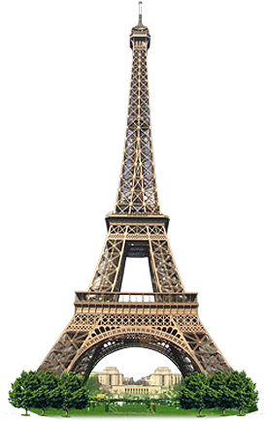
SYMBOLS can be more than just products or companies

Slide 9
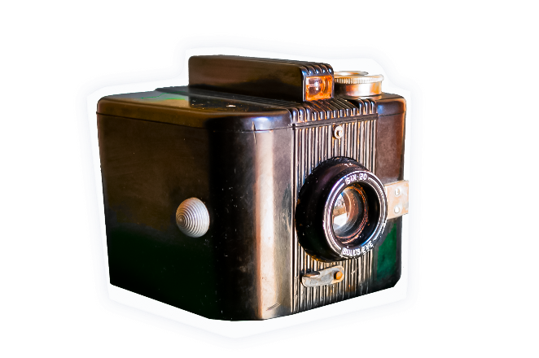
Identity – is the distinguishing character or personality of an individual

Slide 10
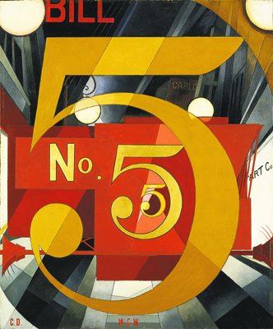
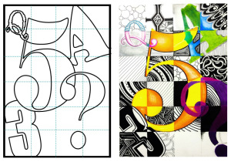
Our Sketchbook Cover

Slide 11
Draw 3-4 different compositions using:
a letter
a number
A symbol or shape that represents YOU
Remember to use:
Cropping, Different Sizes,
“No Kissing”, Use the whole page, rotate, have things off center

Slide 12
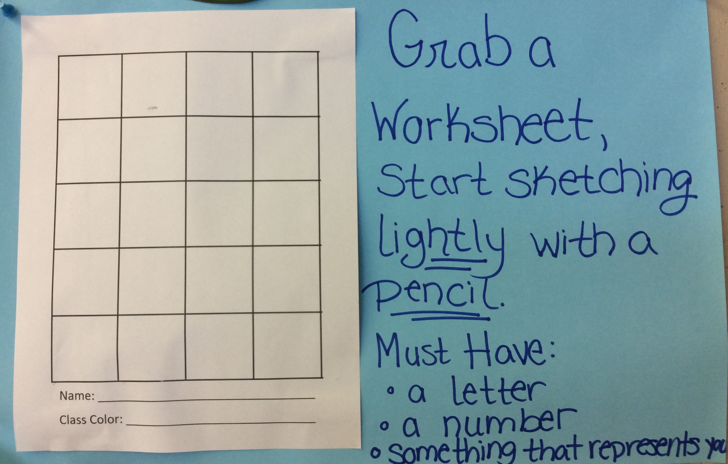
Step 1: Grab your worksheet

Slide 13
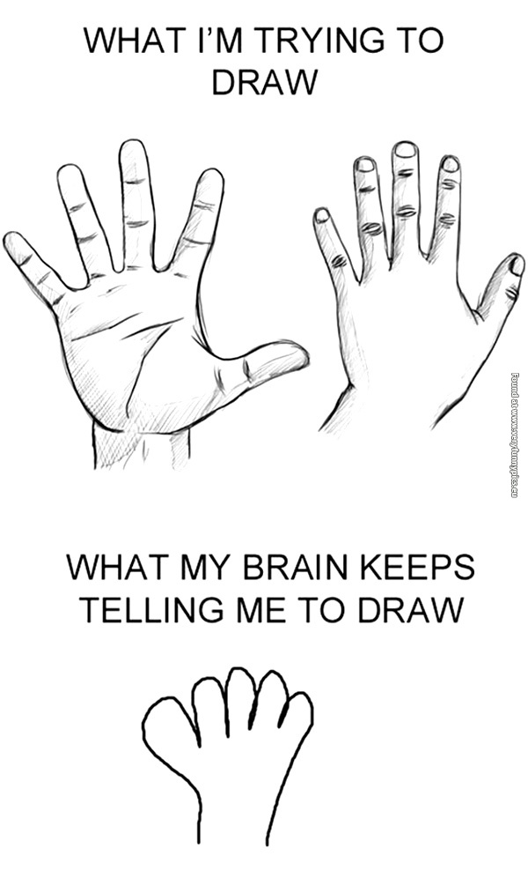
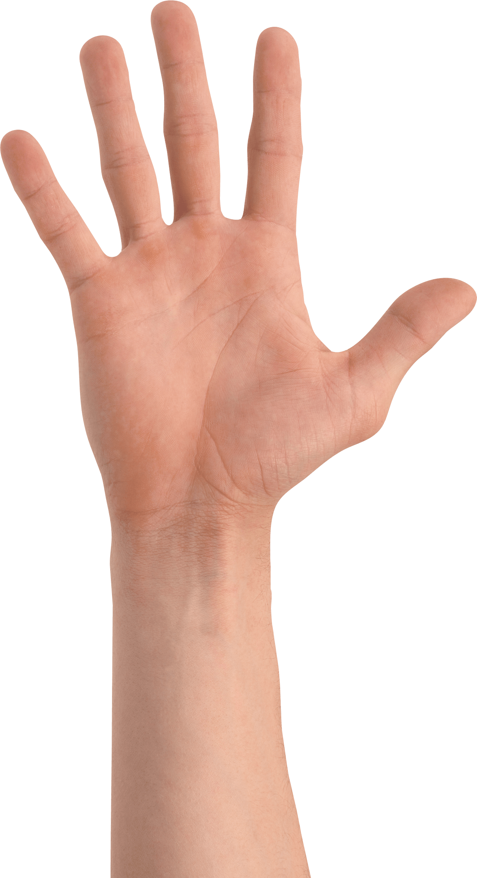
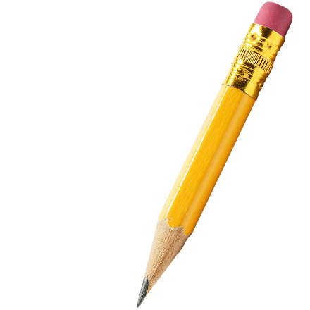
Use a reference

Slide 14
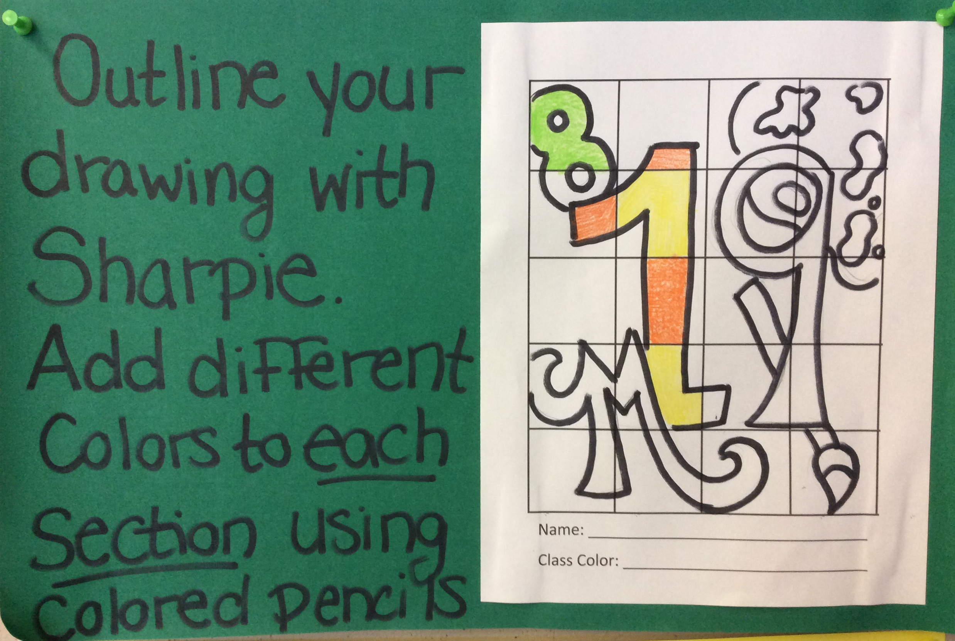
Step 2:

Slide 15
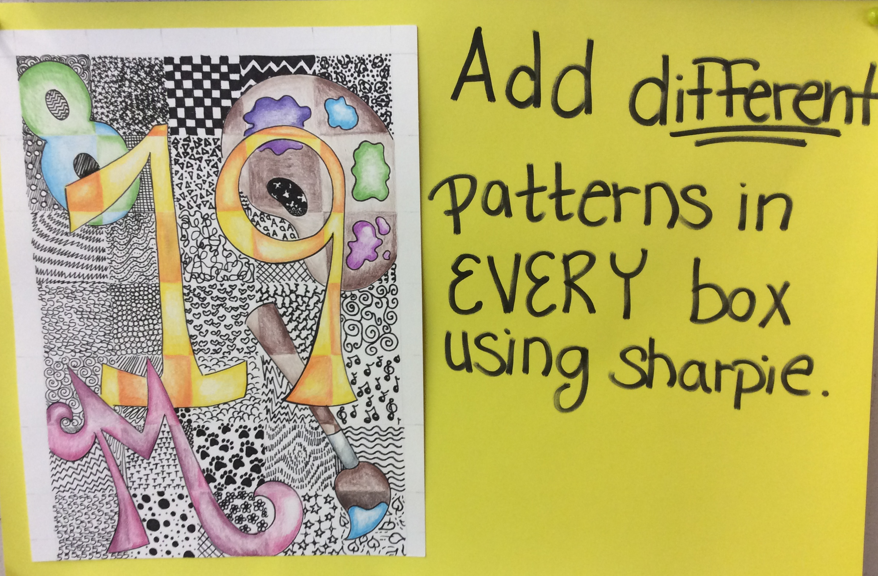
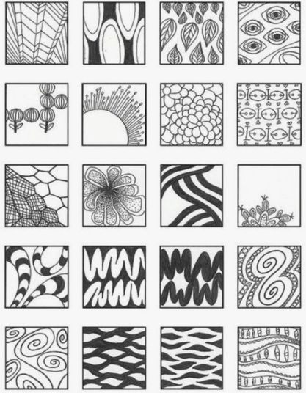
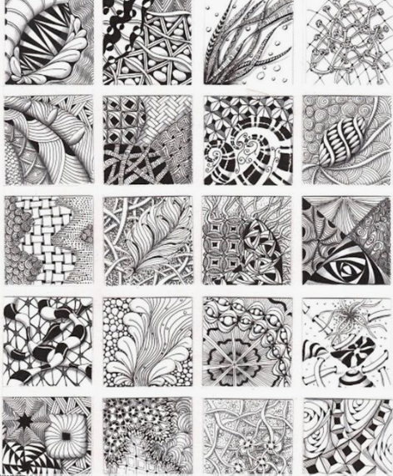
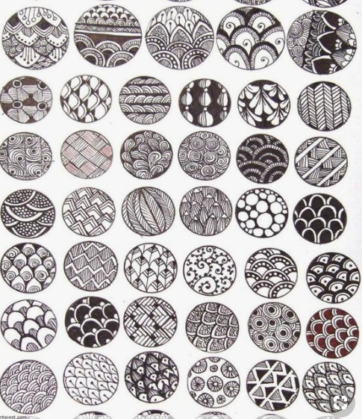
Step 3: Patterns & zentangles

