Slide 1
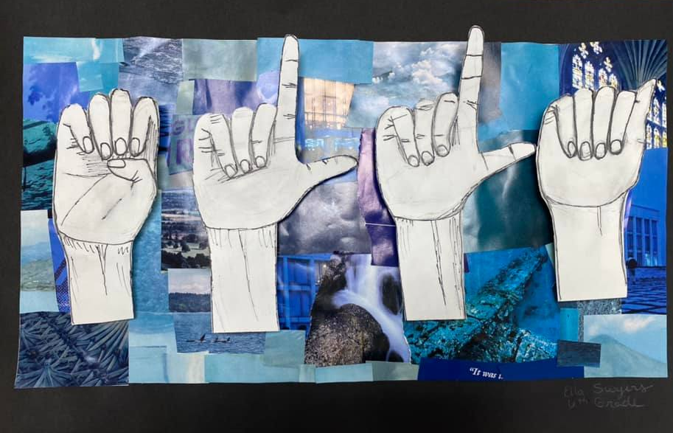
Sign Language Contour Collage
Ms. Salatino

Slide 2
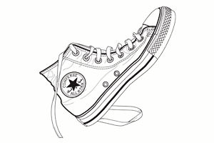
Contour Line-
Contour drawing, is an artistic technique used in the field of art in which the artist sketches the style of a subject by drawing lines that result in a drawing that is essentially an outline; the French word contour meaning, "outline."

Slide 3
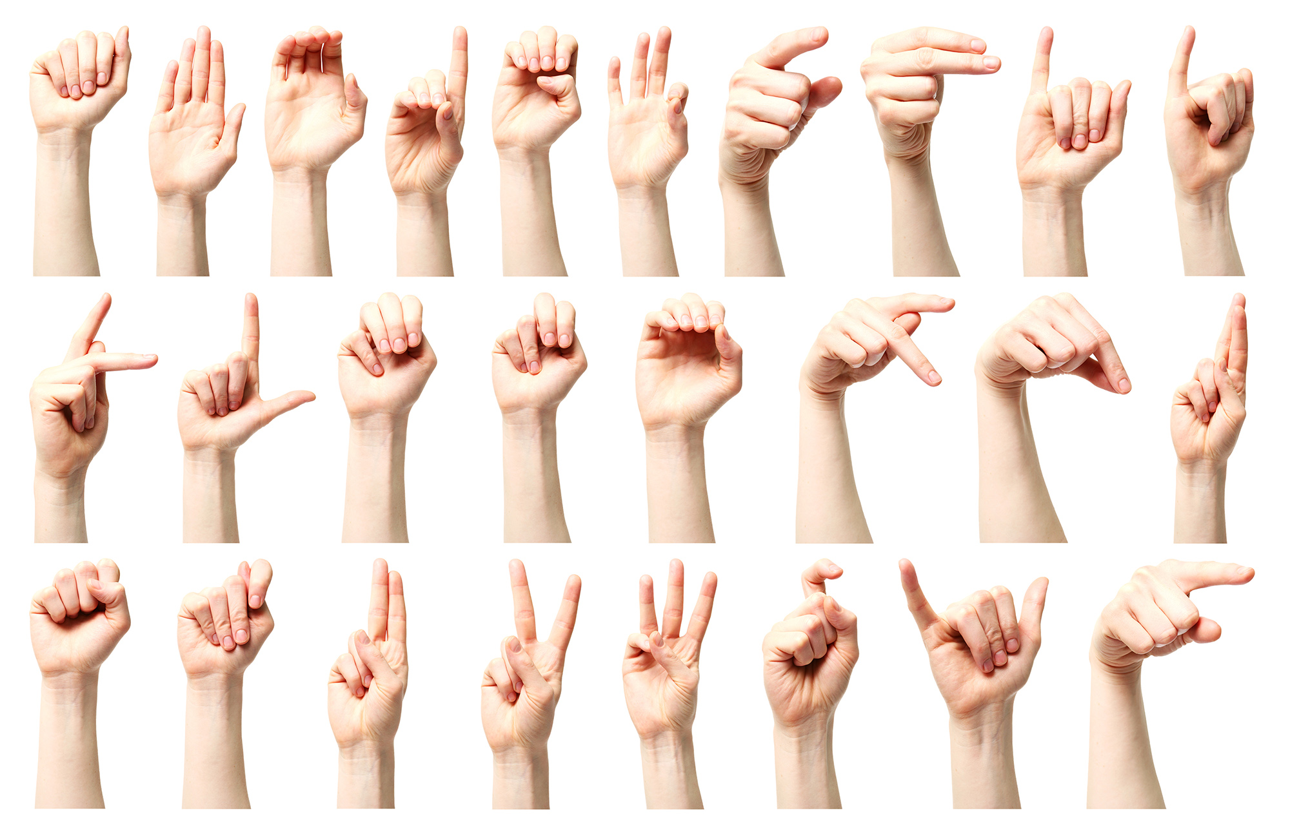

Slide 4
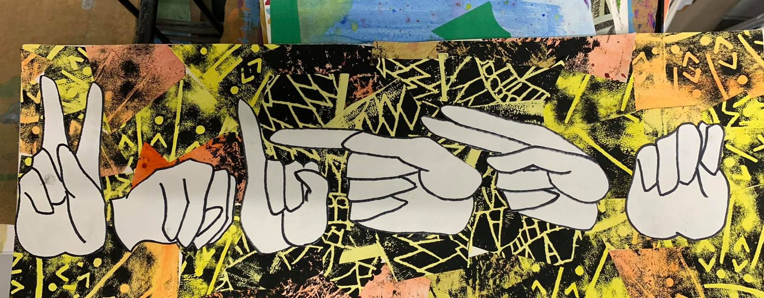

Slide 5
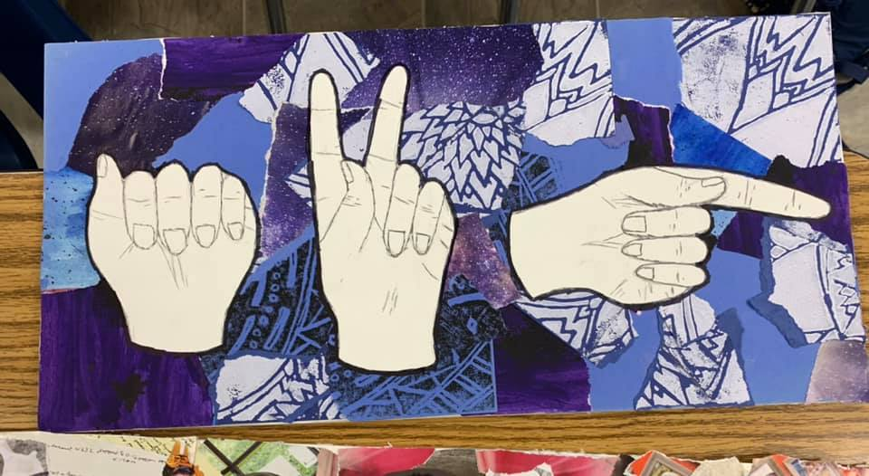

Slide 6
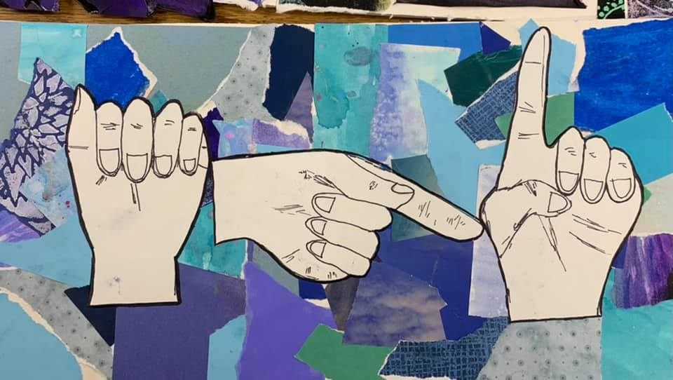

Slide 7
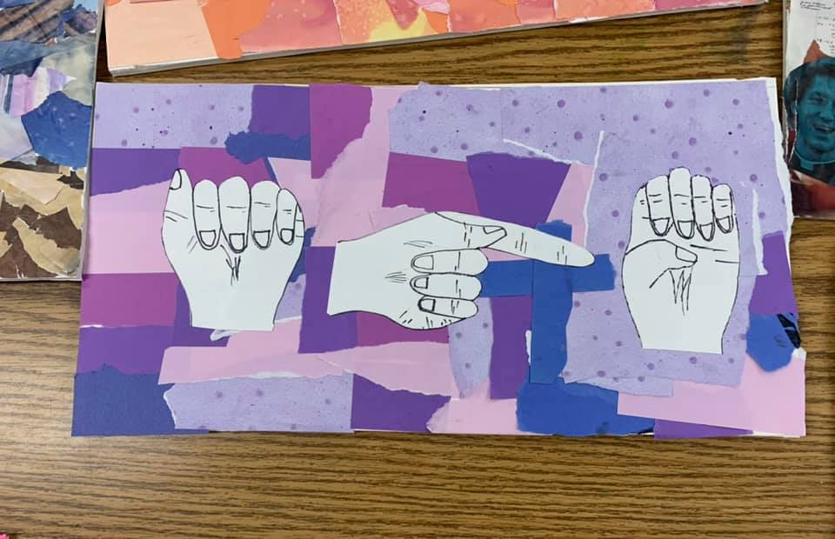

Slide 8
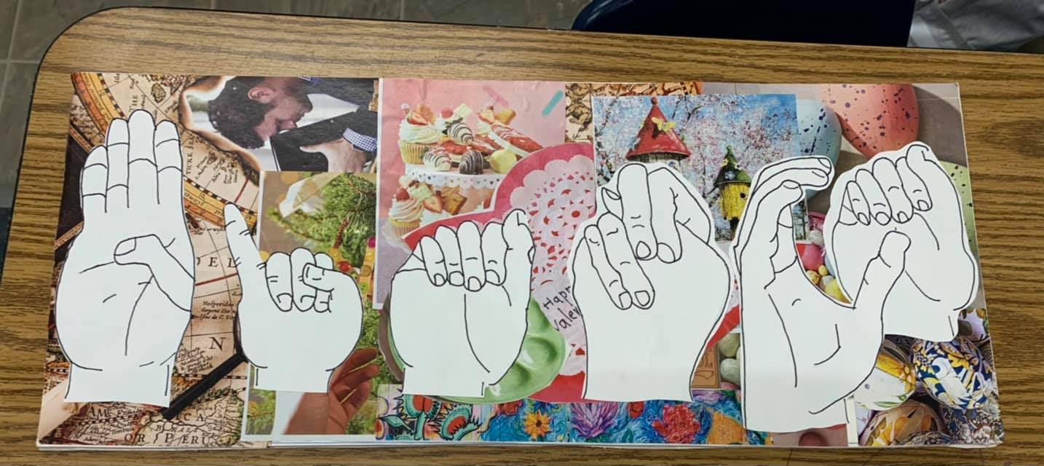

Slide 9
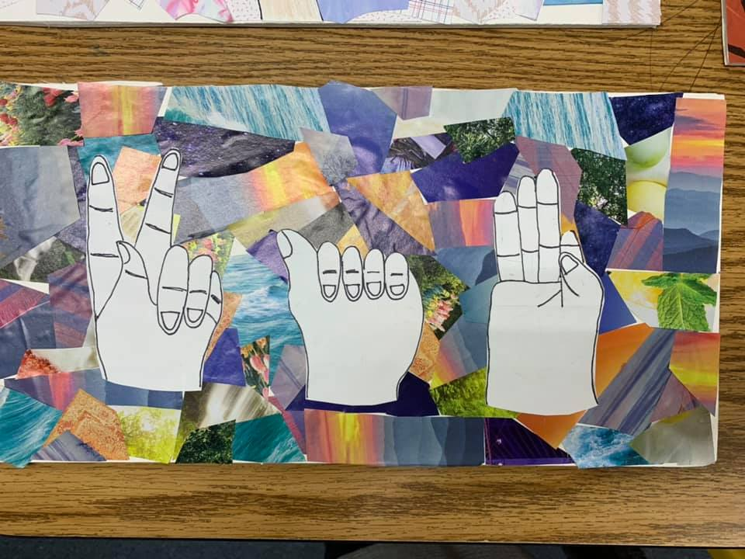

Slide 10
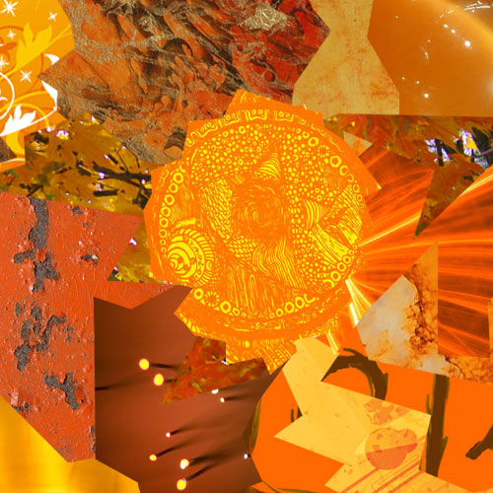
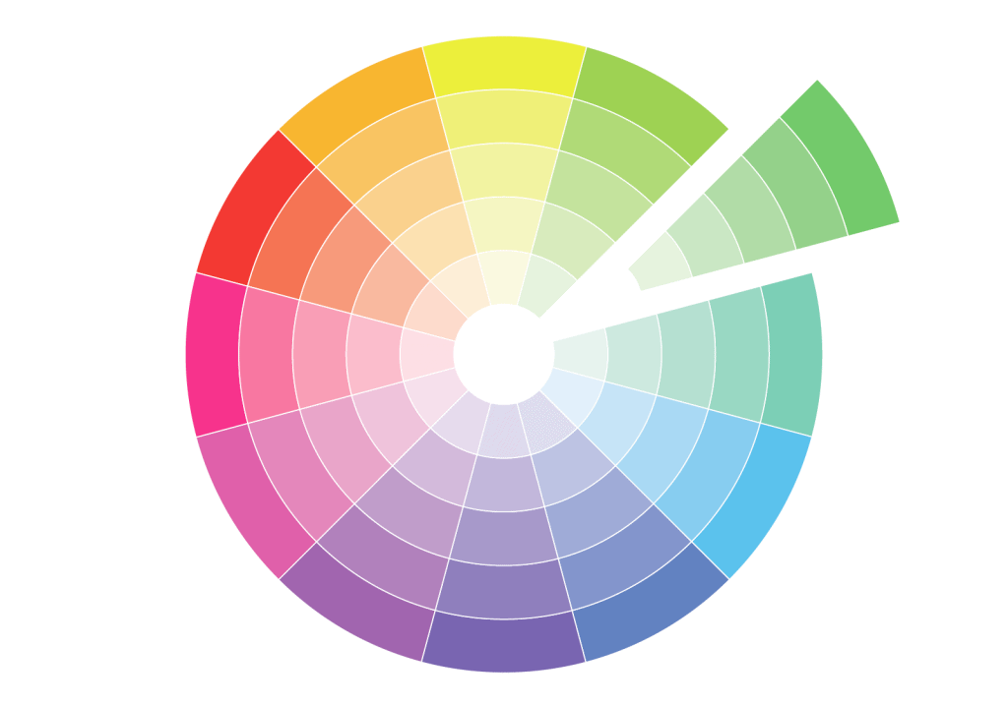
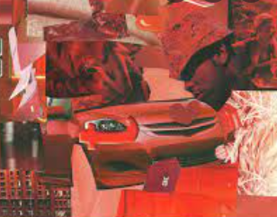
Monochromatic Collage

Slide 11
Tips for drawing hands

Slide 12
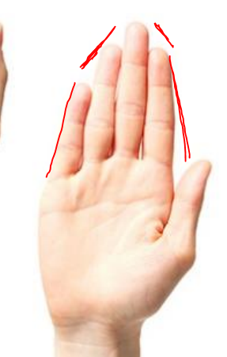
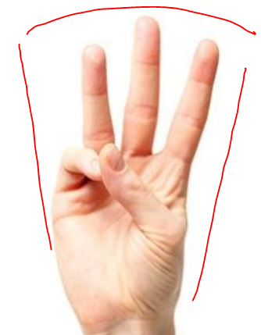
Hands come to a point or fan out

Slide 13
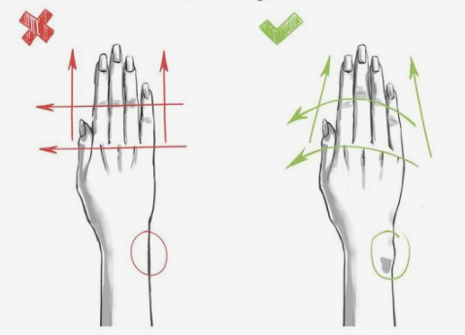
Knuckles and joints curve

Slide 15
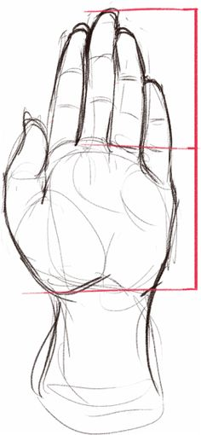
Fingers should be the same length as the palm

Slide 16
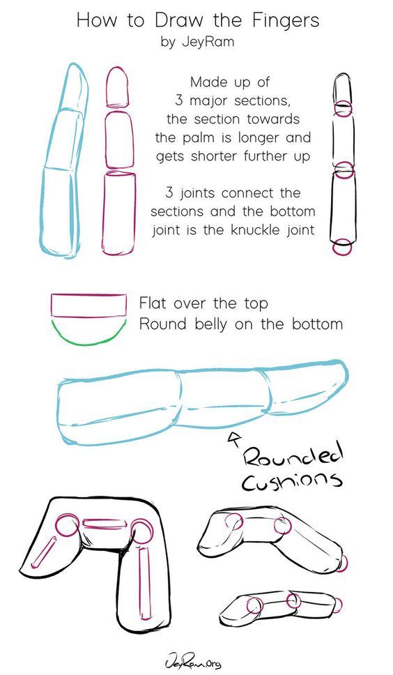
Draw fingers in 3 sections

Slide 17
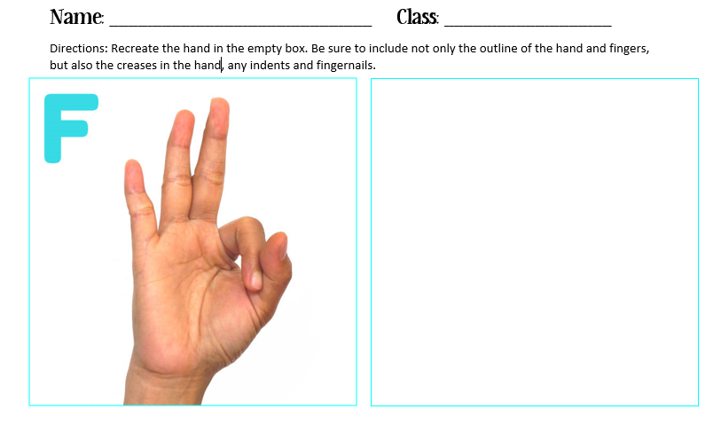

Slide 20
Draw Out Each Hand

Slide 21
Outline in Sharpie

Slide 22
Create a monochromatic collage background (only one color)

Slide 23
Cut out the hands

Slide 24
GLUE

